Slide 1
Recognising His presence
2 June 2024

Slide 2
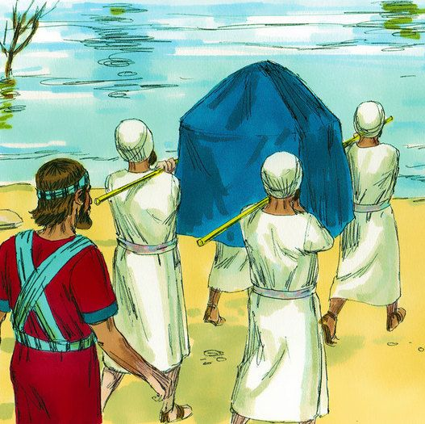
Joshua 3
God has spoken to us of our moving into the next phase in God as being like crossing the Jordan.
When Moses led the Israelites from Pharoah by crossing the Red Sea, the waters parted, and the way was clear from the outset.
Crossing the Jordan, the waters subsided after the priests had carried the ark into the waters.
Notes:
3 Early in the morning Joshua and all the Israelites set out from Shittim and went to the Jordan, where they camped before crossing over. ² After three days the officers went throughout the camp, ³ giving orders to the people: “When you see the ark of the covenant of the Lord your God, and the Levitical priests carrying it, you are to move out from your positions and follow it. ⁴ Then you will know which way to go, since you have never been this way before. But keep a distance of about two thousand cubits^{[a]} between you and the ark; do not go near it.”
⁵ Joshua told the people, “Consecrate yourselves, for tomorrow the Lord will do amazing things among you.”
⁶ Joshua said to the priests, “Take up the ark of the covenant and pass on ahead of the people.” So they took it up and went ahead of them.
⁷ And the Lord said to Joshua, “Today I will begin to exalt you in the eyes of all Israel, so they may know that I am with you as I was with Moses. ⁸ Tell the priests who carry the ark of the covenant: ‘When you reach the edge of the Jordan’s waters, go and stand in the river.’”
⁹ Joshua said to the Israelites, “Come here and listen to the words of the Lord your God. ¹⁰ This is how you will know that the living God is among you and that he will certainly drive out before you the Canaanites, Hittites, Hivites, Perizzites, Girgashites, Amorites and Jebusites. ¹¹ See, the ark of the covenant of the Lord of all the earth will go into the Jordan ahead of you. ¹² Now then, choose twelve men from the tribes of Israel, one from each tribe. ¹³ And as soon as the priests who carry the ark of the Lord—the Lord of all the earth—set foot in the Jordan, its waters flowing downstream will be cut off and stand up in a heap.”
¹⁴ So when the people broke camp to cross the Jordan, the priests carrying the ark of the covenant went ahead of them. ¹⁵ Now the Jordan is at flood stage all during harvest. Yet as soon as the priests who carried the ark reached the Jordan and their feet touched the water’s edge, ¹⁶ the water from upstream stopped flowing. It piled up in a heap a great distance away, at a town called Adam in the vicinity of Zarethan, while the water flowing down to the Sea of the Arabah (that is, the Dead Sea) was completely cut off. So the people crossed over opposite Jericho. ¹⁷ The priests who carried the ark of the covenant of the Lord stopped in the middle of the Jordan and stood on dry ground, while all Israel passed by until the whole nation had completed the crossing on dry ground.

Slide 3
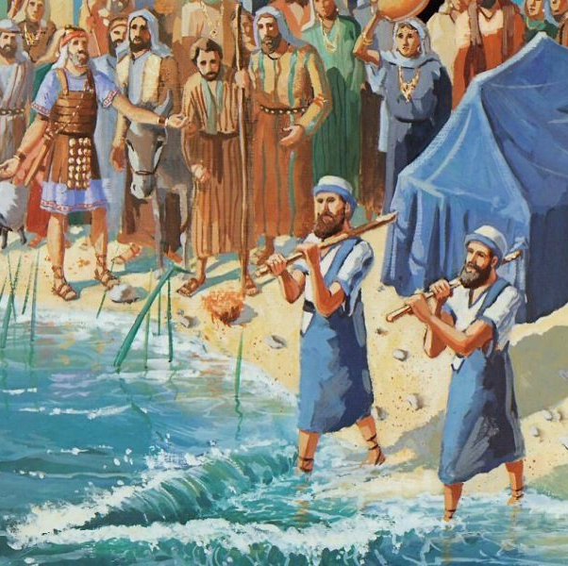
Unreasonable hope
Entering the river requires faith – Heb 11:1 Now faith is the substance of things hoped for, the evidence of things not seen.
What things do you hope for?
Crossing successfully requires God’s word and His presence
Notes:
Faith - based on what God has said
The ark represents the presence of god
Not a magic talisman
David tried to move the ark in the wrong way and a man ended up dead.
We can’t control the presence, but God wants us to carry him with us as we step into the new things he has for us.
Crossing the Jordan was an entry into new things
Greatly contested and impossible without God’s help
Required consecration of everyone
Carried by the leadership/priests
THE MOST IMPORTANT CHARACTERISTIC OF LEADERS IS TO CARRY THE PRESENCE OF GOD WHEREVER THEY GO

Slide 4
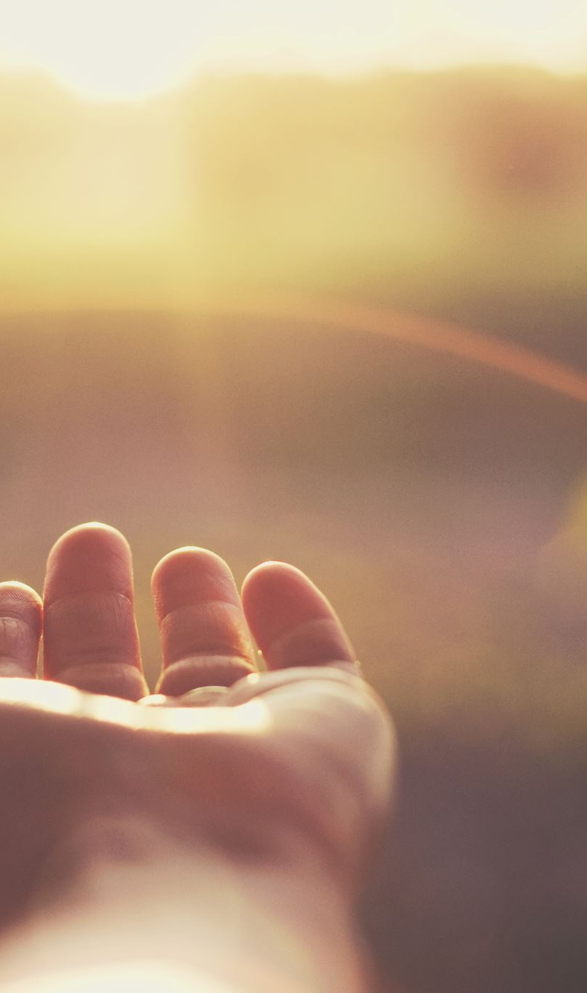
God’s presence is
A gift – we can’t earn it, it’s a gift of his grace
A promise – we can expect it because He has said He will come alongside us
A responsibility – no one can meet with God and be unchanged
A relationship – our love of God needs an object. He wants us to know him, not just know about him.
“Knowing God is not an optional part of the Christian life; it is the Christian life.”
Notes:
Thank you for this food and your presence with us
Matt 28 20 And surely I am with you always, to the very end of the age
Acts 1//;8 ⁸ But you will receive power when the Holy Spirit comes on you; and you will be my witnesses in Jerusalem, and in all Judea and Samaria, and to the ends of the earth.”
A gift
A promise
A power
A revelation
A responsibility
A relationship
When we speak of knowing God, it is important to understand that we are not talking about abstract or speculative thought concerning God or mystical experiences but about coming alive to God through Jesus Christ and surrendering ourselves to Him in grateful love (Rom. 12:1 Therefore, I urge you, brothers and sisters, in view of God’s mercy, to offer your bodies as a living sacrifice, holy and pleasing to God—this is your true and proper worship.). As John says, “Whoever has the Son has life; whoever does not have the Son of God does not have life” (1 John 5:12).
Knowing God is not an optional part of the Christian life; it is the Christian life. Jesus said, “And this is eternal life, that they know you, the only true God, and Jesus Christ whom you have sent” (John 17:3). The English word know in this verse is a translation of the Greek word ginosko, which, in this context, means an experiential knowing, not simply an intellectual understanding of facts about God or Jesus or the Bible. In other words, it refers to an “I-Thou” relationship.

Slide 5
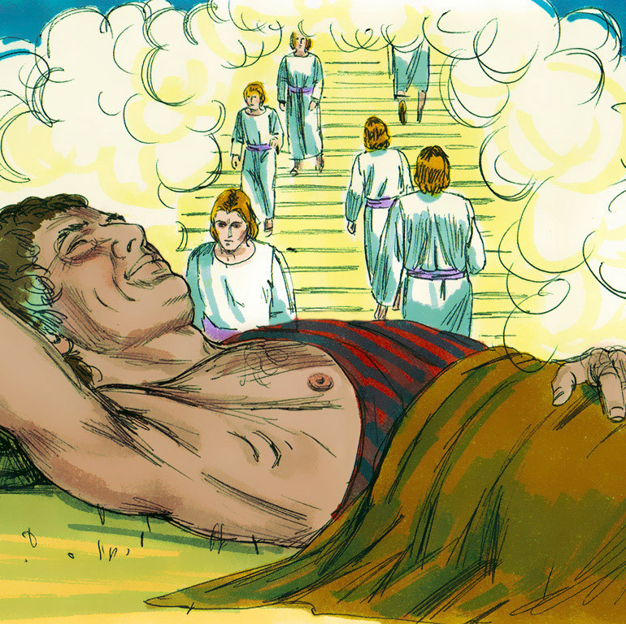
Gifts are given not earnt
On the run from Esau, after deceiving his father into giving him the blessing of his brother, Jacob dreams about a stairway that links heaven and earth.
Gen 28 16 ‘Surely the Lord is in this place, and I was not aware of it.’
Notes:
¹¹ When he reached a certain place, he stopped for the night because the sun had set. Taking one of the stones there, he put it under his head and lay down to sleep. ¹² He had a dream in which he saw a stairway resting on the earth, with its top reaching to heaven, and the angels of God were ascending and descending on it. ¹³ There above it^{[c]} stood the Lord, and he said: ‘I am the Lord, the God of your father Abraham and the God of Isaac. I will give you and your descendants the land on which you are lying. ¹⁴ Your descendants will be like the dust of the earth, and you will spread out to the west and to the east, to the north and to the south. All peoples on earth will be blessed through you and your offspring.^{[d]} ¹⁵ I am with you and will watch over you wherever you go, and I will bring you back to this land. I will not leave you until I have done what I have promised you.’
¹⁶ When Jacob awoke from his sleep, he thought, ‘Surely the Lord is in this place, and I was not aware of it.’ ¹⁷ He was afraid and said, ‘How awesome is this place! This is none other than the house of God; this is the gate of heaven.’
¹⁸ Early the next morning Jacob took the stone he had placed under his head and set it up as a pillar and poured oil on top of it. ¹⁹ He called that place Bethel,^{[e]} though the city used to be called Luz.
²⁰ Then Jacob made a vow, saying, ‘If God will be with me and will watch over me on this journey I am taking and will give me food to eat and clothes to wear ²¹ so that I return safely to my father’s household, then the Lord^{[f]} will be my God ²² and^{[g]} this stone that I have set up as a pillar will be God’s house, and of all that you give me I will give you a tenth.’
Quite a mess, but god blessed him with a dream that was to change his perspective. How many things do we do in our lives because we don’t really believe that God is in this place?
Chapel experience.

Slide 6
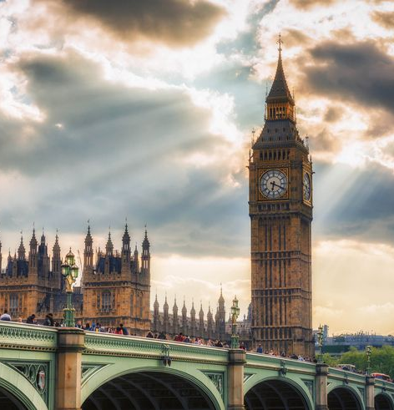
God meets us where we are
Jacob had done nothing to prepare for this
It opened his eyes to God being with him, where he was
Be on the lookout for God in the everyday
Don’t need a special place or particular song
Our God enjoys it when we draw close to Him whenever and wherever we do
He wants relationship, not duty
Notes:
Communion service
When you come to knowing God, the initiative lies on His side. If He does not show Himself, nothing you can do will enable you to find Him. And, in fact, He shows much more of Himself to some people than to others—not because He has favourites, but because it is impossible for Him to show Himself to a man whose whole mind and character are in the wrong condition. Just as sunlight, though it has no favourites, cannot be reflected in a dusty mirror as clearly as in a clean one.

Slide 7
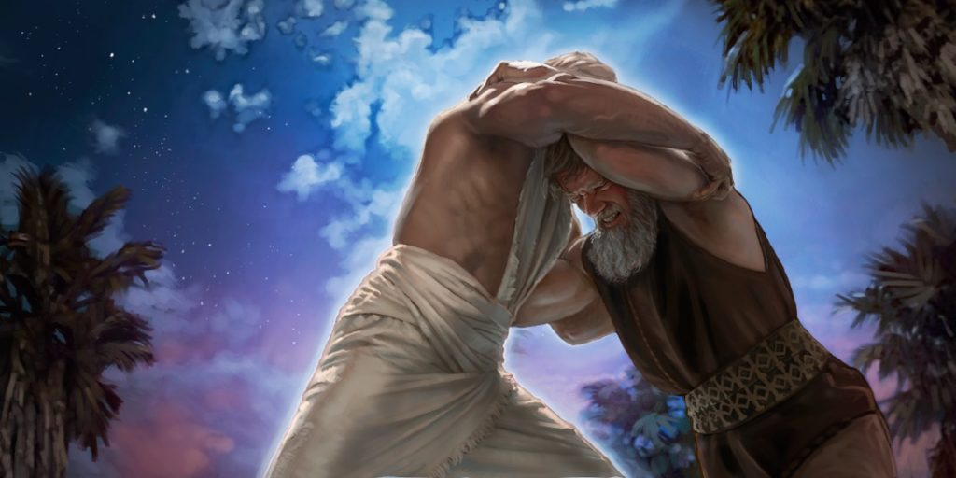
Encounters can be a struggle
Jacob was preparing to be reunited with his brother and, having sent all his belongings and family ahead of him, a man appeared and began to wrestle with him.
Jabbok was a crossing point on a tributary of the river Jordan
Jabbok means "a place of passing over". It also stands for a struggle; to empty and pour out.
Notes:
Jacob wrestles with God
²² That night Jacob got up and took his two wives, his two female servants and his eleven sons and crossed the ford of the Jabbok. ²³ After he had sent them across the stream, he sent over all his possessions. ²⁴ So Jacob was left alone, and a man wrestled with him till daybreak. ²⁵ When the man saw that he could not overpower him, he touched the socket of Jacob’s hip so that his hip was wrenched as he wrestled with the man. ²⁶ Then the man said, ‘Let me go, for it is daybreak.’
But Jacob replied, ‘I will not let you go unless you bless me.’
²⁷ The man asked him, ‘What is your name?’
‘Jacob,’ he answered.
²⁸ Then the man said, ‘Your name will no longer be Jacob, but Israel,^{[f]} because you have struggled with God and with humans and have overcome.’
²⁹ Jacob said, ‘Please tell me your name.’
But he replied, ‘Why do you ask my name?’ Then he blessed him there.
³⁰ So Jacob called the place Peniel,^{[g]} saying, ‘It is because I saw God face to face, and yet my life was spared.’
Jabbok means "a place of passing over". It also stands for struggle; to empty and pour out.
Story of the dustmen; the walk with colin
The story of Jacob should encourage us to believe that God is willing to get down into the dirt, into the mess of our lives and into the nitty gritty of our daily reality, to hear out our pain, our struggles and our disappointments – why do we think we can hide these from God anyway? The story should also teach us, that it is in the place of struggle, of contention and of facing uncomfortable feelings and realities that God is able to touch us, transform us and bless us.
As we wrestle with God in the dark times and push through until daybreak we may discover a surprising outcome - our name has been changed and we have crossed over to somewhere new. It is true, we may walk differently afterwards, but we will walk closer to God, in greater intimacy and reliance on his goodness and love.

Slide 8
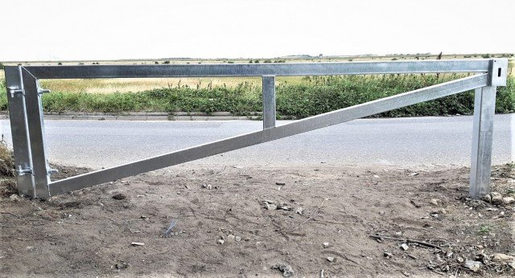
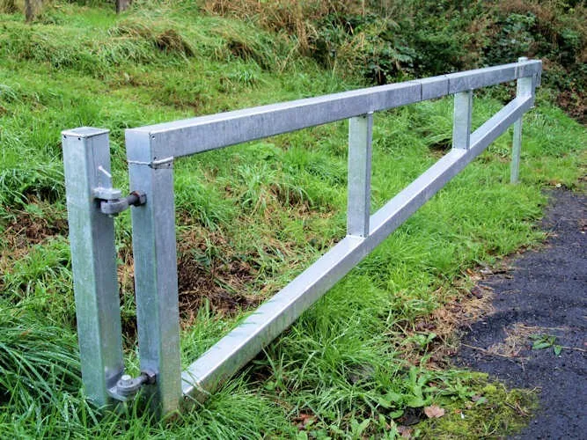
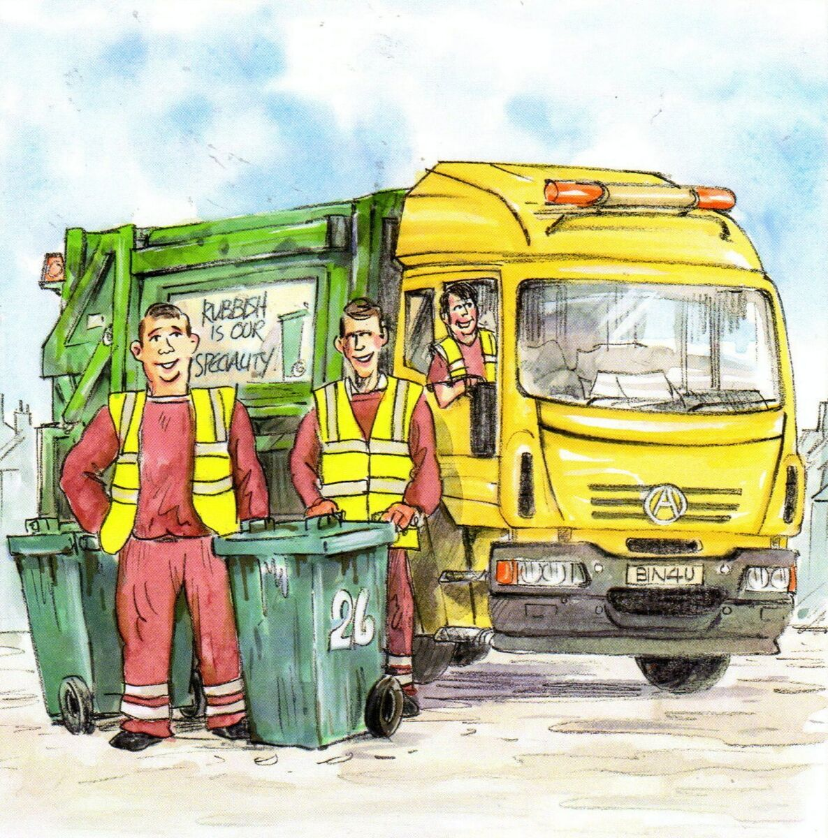
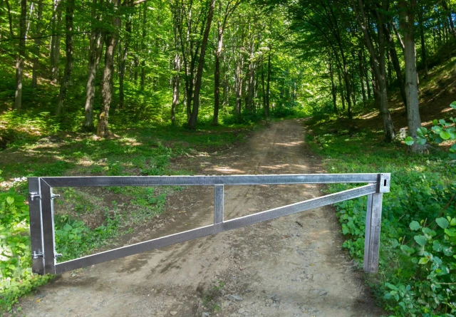

Slide 9
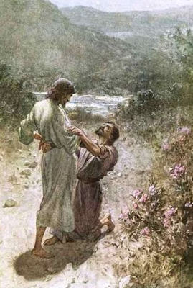
I will not let you go unless you bless me
Jacob owns up to who he is when he says his name – Jacob means deceiver, or schemer
But God has new promise for him and renames him Israel – God rules
God’s touch changes us for life
Notes:
As the sun set, Jacob was fearful and apprehensive. As the sun rose, he was broken and blessed.
Having confronted and confessed his own crookedness, he was now ready to cross the crooked Jabbok and enter the Land of Promise.
He does so having received what he wanted and what he didn’t want.
He wanted God’s blessing. But with the blessing came a limp, which characterized Jacob’s gait for the rest of his life.
Jacob entered this midnight match physically whole, but spiritually lame.
He now crosses the Jabbok physically lame, but spiritually whole.

Slide 10
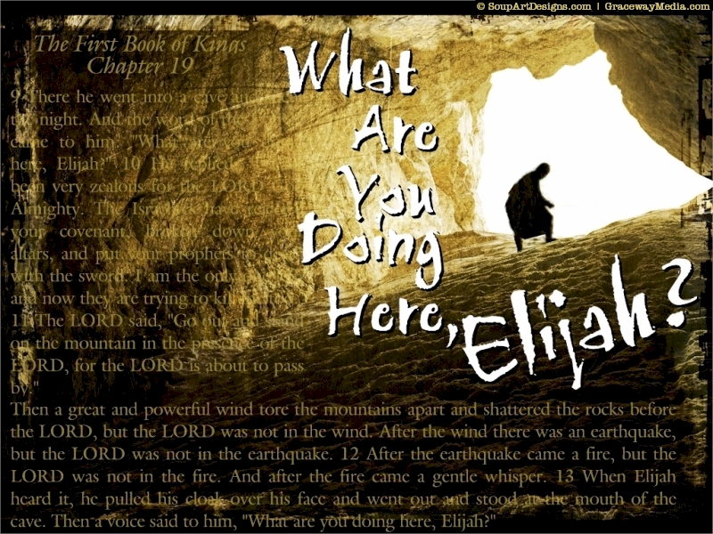
God meets us as He wants
Not in the wind
Not in the earthquake
Not in the fire
But in the gentle whisper
Notes:
And the word of the Lord came to him: “What are you doing here, Elijah?”
¹⁰ He replied, “I have been very zealous for the Lord God Almighty. The Israelites have rejected your covenant, torn down your altars, and put your prophets to death with the sword. I am the only one left, and now they are trying to kill me too.”
¹¹ The Lord said, “Go out and stand on the mountain in the presence of the Lord, for the Lord is about to pass by.”
Then a great and powerful wind tore the mountains apart and shattered the rocks before the Lord, but the Lord was not in the wind. After the wind there was an earthquake, but the Lord was not in the earthquake. ¹² After the earthquake came a fire, but the Lord was not in the fire. And after the fire came a gentle whisper. ¹³ When Elijah heard it, he pulled his cloak over his face and went out and stood at the mouth of the cave.
Then a voice said to him, “What are you doing here, Elijah?”
NOT IN THE MANNER,
NOT IN THE TIME,
NOT WITH THE ANSWER THAT WE WANT
BUT WE KNOW IT IS HIM
AND WE ARE CHANGED AS A RESULT

Slide 11

Recognise and expect His presence
He is always with us – so let us live as though he is!
And there are times when his presence is more intense, more real
Be prepared to wait, to stop, and look, and listen
Don’t save it for a Sunday, take time to draw close in the everyday
Nothing else touches us like he does
Notes:
More recently assembly experience
Might not be convenient or
“Sometimes we experience a terrible dryness in our spiritual lives. We feel no desire to pray, don’t experience God’s presence, get bored with worship services, and even think that everything we ever believed about God, Jesus, and the Holy Spirit is little more than a childhood fairy tale.
Then it is important to realize that most of these feelings and thoughts are just feelings and thoughts, and that the Spirit of God dwells beyond our feelings and thoughts. It is a great grace to be able to experience God’s presence in our feelings and thoughts, but when we don’t, it does not mean that God is absent. It often means that God is calling us to a greater faithfulness. It is precisely in times of spiritual dryness that we must hold on to our spiritual discipline so that we can grow into new intimacy with God.” (emphasis added)
(from Bread for the Journey: A Daybook of Wisdom and Faith and
The Only Necessary Thing: Living a Prayerful Life both by Henri Nouwen)
my Prayer:
Lord, I’m going to keep listening for your voice even when I think I can’t hear you.
I’m going to keep looking for you even when I think I can’t find you.
I’m going to keep talking to you even when I think I’m not making sense.
I’m going to keep reading your word even when I think I don’t understand it.
I’m going to keep serving you even when I’m not sure I’m doing any good at all.
I’m going to keep singing to you, knowing you can hear both my words and my heart.
Lord, I know these thoughts and feelings are lies. I’m so thankful that my faith isn’t grounded in them because they are temporary.
You are eternal. And you are here with me, whether I can sense your presence or not.
Thank you for that knowledge, it’s my rock.

Slide 12
