Slide 1
Pressing on toward the goal
Reflections on Psalm 118
17 Dec 2023
Notes:
^{Phil 312} Not that I have already obtained all this, or have already arrived at my goal, but I press on to take hold of that for which Christ Jesus took hold of me. ¹³ Brothers and sisters, I do not consider myself yet to have taken hold of it. But one thing I do: Forgetting what is behind and straining toward what is ahead, ¹⁴ I press on toward the goal to win the prize for which God has called me heavenward in Christ Jesus.
Over the past term we have been seeing God do amazing things in the time of the Kings, but we have reached a point now of what feels like utter hopelessness
How can faith survive for ordinary people in the time of the Kings?
We’ve seen poor leadership, making idols, wrong priorities and even encouragement to sin – worshipping of idols etc
But in the midst of all of it, there are those who know Gods voice. Today we can learn to do the same.
The bible is a book, but it is made from collection of books: history, poetry, wisdom, prophecy and letters
Can be hard to get your head around where all the books fit together.

Slide 2
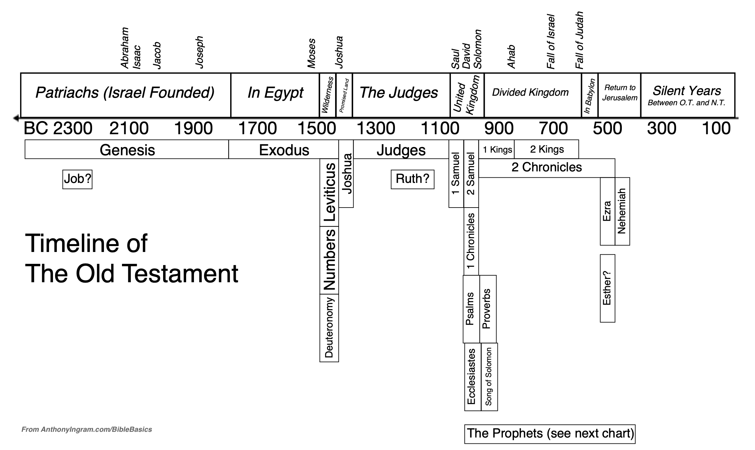
Notes:
First of all we can see that what we are looking at in 1 and 2 kings is towards the latter half of OT history.
And secondly we can see that the Prophets appear in parallel with the books of Kings

Slide 3
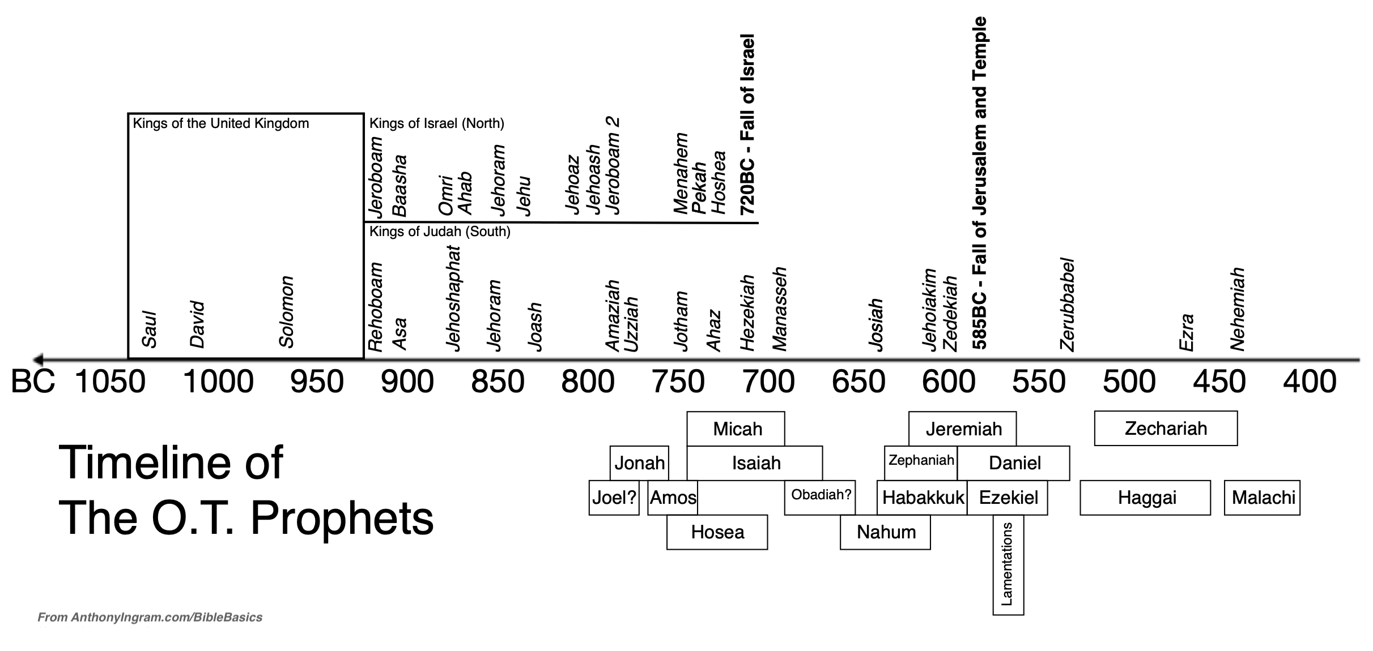
1 Kings and 2 Kings
Notes:
God sent the prophets to speak into the mess that was the divided kingdom
When surrounded by the nonsense that was the life of Kings, these people like you and me were able to hear God because they had turned to him for help,
God gave Isaiah a vision that became the longest book of prophecy ever recorded;
BUT It started with a revelation that he was a man of unclean lips, the cleansing of God and a willingness to be sent
7With it he touched my mouth and said, “See, this has touched your lips; your guilt is taken away and your sin atoned for.”
8Then I heard the voice of the Lord saying, “Whom shall I send? And who will go for us?”
And I said, “Here am I. Send me!”
Around 750BC, Gog gave I a vision of the kingdom to come

Slide 4
Isaiah 9:6-7
For to us a child is born, to us a son is given, and the government will be on his shoulders.
And he will be called Wonderful Counsellor, Mighty God, Everlasting Father, Prince of Peace.
Of the greatness of his government and peace there will be no end.
He will reign on David’s throne and over his kingdom, establishing and upholding it with justice and righteousness from that time on and forever.
The zeal of the Lord Almighty will accomplish this.
Notes:
We celebrate the birth of this Child at Christmas
Into the midst of these tales of terrible Kings, God gave Isaiah a vision of a King and a Kingdom that would never pass away

Slide 5
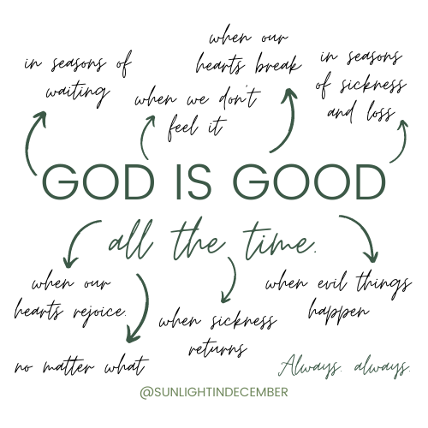
Ps 118
¹ Give thanks to the Lord, for he is good;
his love endures for ever.
² Let Israel say:
‘His love endures for ever.’
³ Let the house of Aaron say:
‘His love endures for ever.’
⁴ Let those who fear the Lord say:
‘His love endures for ever.’
Notes:
In its ancient Jewish context, Psalm 118 was most likely an entrance liturgy to the Temple, used at the festival of Passover. It proclaimed God’s deliverance from Egypt and, later on, from the Exile.
Psalm 118 does not name an author in its title, but there is reason to believe it was David. Ezra 3:10-11 suggests that Psalm 118 was sung at the founding of the second temple, and when they sang it, they attributed it to David (“according to the ordinance of David king of Israel,” Ezra 3:10).
Though this was likely David’s psalm, it was also Jesus’ psalm. “This is pre-eminently the triumph song of the Christ, He the ideal Servant, He the perfect Priest, He the Leader of the people. How much all these words meant to Him as He sang them on that night in the upper room.” (G. Campbell Morgan)
God is good, but the enemy lies. When confronted with evil in the world the enemy would have us believe that God is far off and doesn’t care.
But our message of hope is that God is right there in the midst. God give us grace to show suffering friends that this is so. (my father?)
This Psalm was used as part of the Passover meal, very likely on the night of Jesus’s betrayal.
As we work through this together, let’s try to get a handle of what the words meant for him and what they mean for us.
We’ll see throughout the psalm how the author repeats things for emphasis. We need to repeat truths to ourselves. Of course you heard it the first time, but you need to hold on to the truth when things are tough.
Verses 1 - 4 tell everybody to thank the *LORD, because he is good. In verse 2, "Israel" means all the people that live in the land of Israel. In verse 3, "the house of Aaron" means the *priests and levites of Israel. *Priests were special servants of God who worked in the *temple at Jerusalem. The levites also worked in the *temple, and in the towns and villages of Israel. The words "kind love" come in all 4 verses. "Kind love" is a special love. In Hebrew, it is "hesed". It is not human love. It is the love that God showed in his *covenant. It is a love that gives help, and never stops.

Slide 6
His love endures forever
Col 1
²⁸He is the one we proclaim, admonishing and teaching everyone with all wisdom, so that we may present everyone fully mature in Christ. ²⁹To this end I strenuously contend with all the energy Christ so powerfully works in me.
Notes:
To speak of a love that endures in the present tense highlights that God’s love is about being with us in every circumstance of life
But faith is about grace – his undeserved goodness – so what is there to endure?
Col 1 28He is the one we proclaim, admonishing and teaching everyone with all wisdom, so that we may present everyone fully mature in Christ. 29To this end I strenuously contend with all the energy Christ so powerfully works in me.
God has designed it that we both receive the grace and need to use it to be free.
Like when Jesus was asked about the most important commandment….

Slide 7
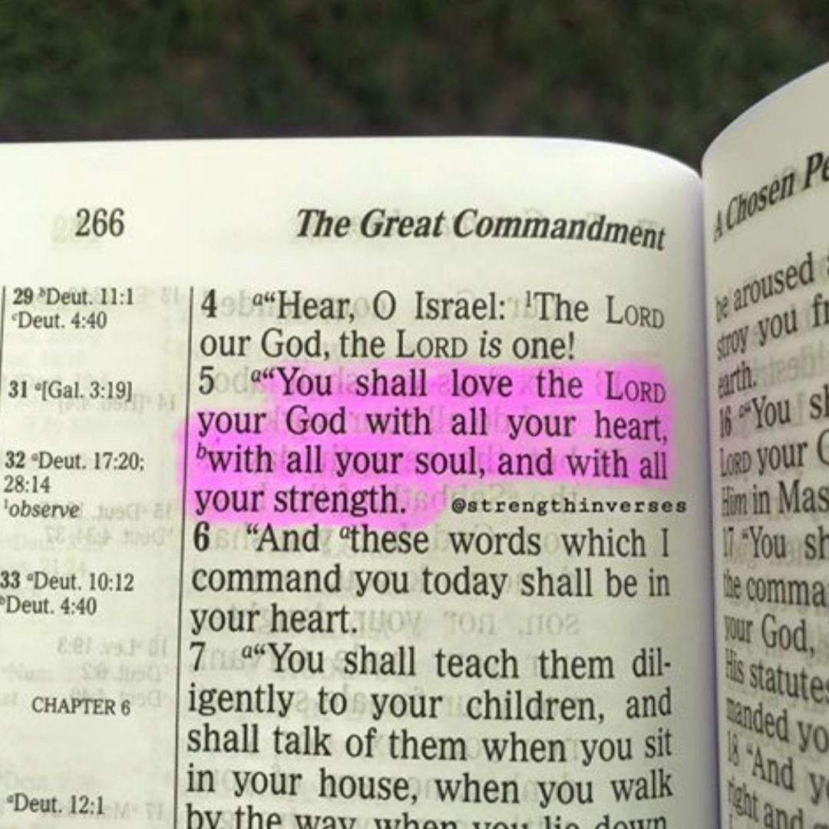
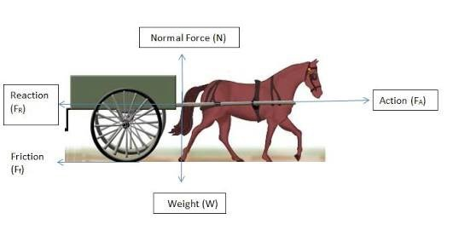
Love drives all other change
³⁵One of them, an expert in the law, tested him with this question:
³⁶“Teacher, which is the greatest commandment in the Law?”
³⁷Jesus replied:
“ ‘Love the Lord your God with all your heart and with all your soul and with all your mind.’ ³⁸This is the first and greatest commandment.
³⁹And the second is like it: ‘Love your neighbour as yourself.’ ⁴⁰All the Law and the Prophets hang on these two commandments.”
Matt 22
Notes:
Whether we realize it or not, we all have certain priorities in life. Some things are more important to us than others. And those that are the most important shape our lives in significant ways. This is as true for the day laborer as it is for the corporate executive. Our priorities are slowly turning us into a certain kind of person and shaping our destinies.
Jesus says the first and greatest of God’s commandments is to “love the Lord your God with all your heart and with all your soul and with all your mind and with all your strength” (Mark 12:30, italics added).¹ The passage from the Old Testament (Deut. 6:4–5) is a foundational command for our relationship with God.
The repetition of all and its application to the various aspects of our nature means that we are to love God with all that we are, with every part of our being: intellect, emotion, will, and desire. We are to become God-centered people; He is to be first in our lives, above everyone and everything, without exception. From this all other priorities will find their place.
Loving God
Loving God wholeheartedly lies at the heart of spiritual health, and the more we love Him the healthier we are.
, C.S. Lewis says, “Every Christian would agree that a man’s spiritual health is exactly proportional to his love for God.”
But it is also important to note that Jesus was asked about the most important commandment – and he GIVES TWO ANSWERS

Slide 8
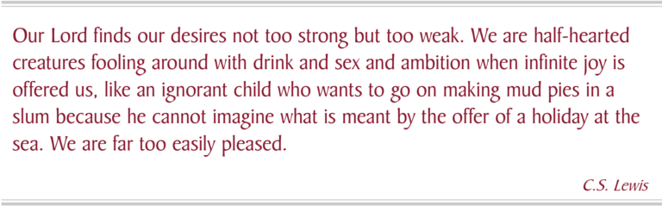
Notes:
Our lord himself invites us to the highest calling of all – intimacy with him- and day after day we decline the offer, preferring to fill our stomachs with the pods of short lived pleasures and prospects.
Ken Boa
Take some time to consider your own time with God. Does it satisfy?
God says taste and see that the Lord is good.
He satisfies our desires with good things….

Slide 9
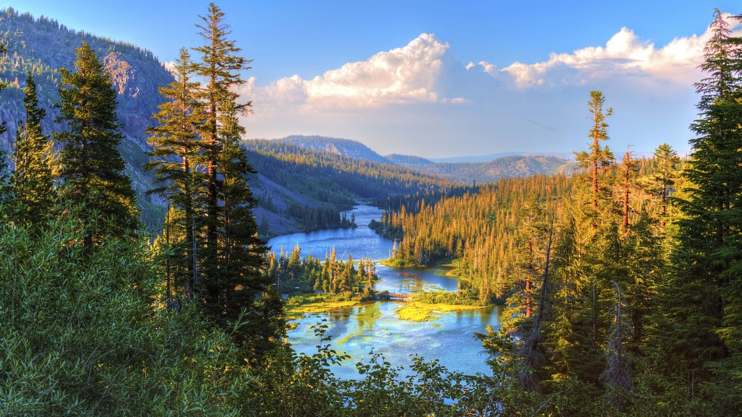
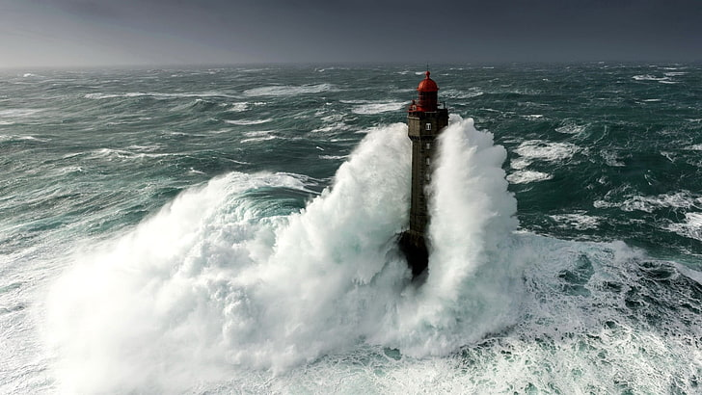
⁵ When hard pressed, I cried to the Lord;
he brought me into a spacious place.
⁶ The Lord is with me; I will not be afraid.
What can mere mortals do to me?
⁷ The Lord is with me; he is my helper.
I look in triumph on my enemies.
⁸ It is better to take refuge in the Lord
than to trust in humans.
⁹ It is better to take refuge in the Lord
than to trust in princes.
Notes:
We can cry to many things and people to fix things and make life better
But only one thing counts.
Hard pressed is to be in Anguish, in dire straits or distress
He sets me free , or brings me to a spacious place, a place with no boundaries, a place without restrictions
God is with me. Not just present, but behind me, supporting me, on my side.
Taking refuge:
There are many examples in the Bible of people “fleeing to the mountains”: Adam and Eve, Saul, Jonah, Israel and Judah, Peter. But how should the church respond to threatening circumstances? The Bible gives us two basic choices: we can either flee to the hills, or we can take refuge in God. And, of course, we do well to follow David’s lead
Let our day of worship be a day of choosing the right way forward in whatever difficulty and distress we face. Let it be a day of taking refuge in God.
Taking Refuge in God
When tempted to flee the pressures of life, the Scriptures call us to hide ourselves in God. Only God can offer true refuge from life’s dangers and the misery of our sin.
When we join together each week to worship a righteous God, we proclaim that God not only dwells in heaven, but reigns there: “The Lord is in his holy temple; the Lord’s throne is in heaven” (Psalm 11:4). Taking refuge in God does not always mean immediate escape from pain and suffering. But because God is enthroned, he is in control and unperturbed by the apparent chaos on earth. This doesn’t mean that he is unconcerned with human affairs. It merely means that God is not panicking (Psalm 2:4). He is carrying out his perfect plan.
He remains unshaken and eternally in power, which provides us with confidence in the day of trouble.
We come together and celebrate him as King, no matter what happens on earth.
On the one hand, then, taking refuge in God means hiding in Jesus, the Rock who was cleft for us. But taking refuge in God also goes a step further: it means living a life of holiness in this chaotic world, completely devoted to God. In Christ, God’s people really can perform the “righteous deeds” that God loves, even when “the foundations are destroyed” (Psalm 11:3) and troubles surround us. Any who sincerely follow after God in righteousness and purity will be safe under his protection.

Slide 10
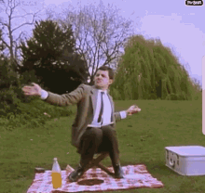
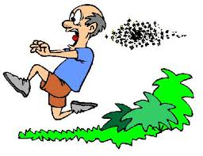
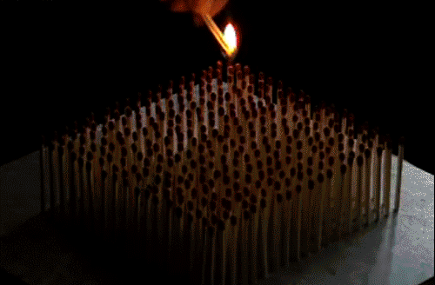
¹⁰ All the nations surrounded me,
but in the name of the Lord I cut them down.
¹¹ They surrounded me on every side,
but in the name of the Lord I cut them down.
¹² They swarmed around me like bees,
but they were consumed as quickly as burning thorns;
in the name of the Lord I cut them down.
¹³ I was pushed back and about to fall,
but the Lord helped me.
¹⁴ The Lord is my strength and my defence^{[or song]};
he has become my salvation.
Notes:
I remember I was at a summer event in the sixth form CR at school . It is high up and it was a bright warm day.
It has a balcony, and the large doors were open to help circulation of air.
The room went dark as a swarm of bees worked their way along the balcony.
A wasp or bee can be a distraction, but this swarm was really quite scary.
The enemy can make difficulties arrive at once. Sometimes it feels like we just get one thing sorted, and another pops up
In the name of the lord I can cut them down. Bird making a nest on your head etc.
God wants to restore your song
Miriam Exodus
15 2“I will sing to the Lord,
for he is highly exalted.
Both horse and driver
he has hurled into the sea.
² “The Lord is my strength and my defense^{[a]};
he has become my salvation.
He is my God, and I will praise him,
my father’s God, and I will exalt him.
³ The Lord is a warrior;

Slide 11
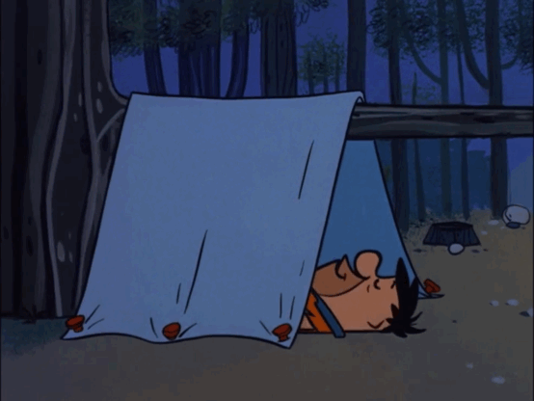
¹⁵ Shouts of joy and victory resound in the tents of the righteous:
Notes:
What sounds in your tent? What do you dwell on, feed on sound again…

Slide 12
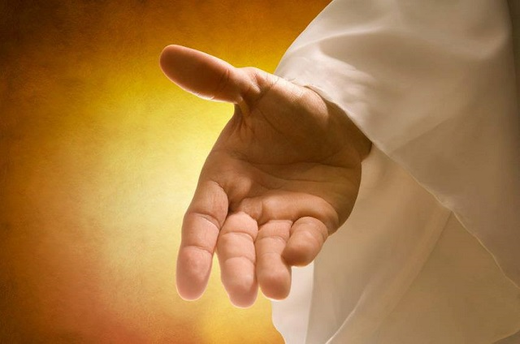
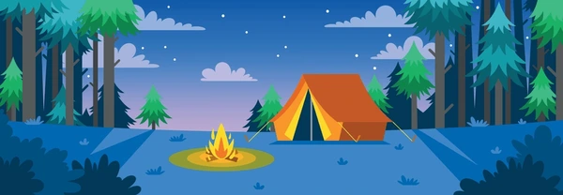
¹⁵ Shouts of joy and victory
resound in the tents of the righteous:
“The Lord’s right hand has done mighty things!
¹⁶ The Lord’s right hand is lifted high;
the Lord’s right hand has done mighty things!”
¹⁷ I will not die but live,
and will proclaim what the Lord has done.
¹⁸ The Lord has chastened me severely,
but he has not given me over to death.
Notes:
Tell your story.
When I was a teenager I struggled with IBS. I had various investigations done, including a barium meal and other things.
At uni I was frequently ill when visiting others.
Healing of ibs after being filled with the spirit
But be clear, it is the lord’s right hand that did it
Fundamental to this psalm is that God is at wrk throughout the story; for Jesus on the night of his betrayal that was also true.

Slide 13
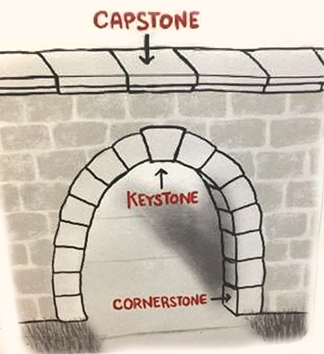
¹⁹ Open for me the gates of the righteous;
I will enter and give thanks to the Lord.
²⁰ This is the gate of the Lord
through which the righteous may enter.
²¹ I will give you thanks, for you answered me;
you have become my salvation.
²² The stone the builders rejected
has become the cornerstone;
²³ the Lord has done this,
and it is marvellous in our eyes.
Notes:
The *Jews have a legend. A legend is a story that may or may not be true. The legend is about building the *temple in Jerusalem. The *temple was the house of God. They cut big stones to build the *temple. One stone was the wrong shape and size. They threw it away. Then they needed one that shape and size. They needed it to fix two walls together. So, they found the stone that they threw away. They put it in an important place at the top of the two walls. It fixed the two walls together. As Psalm 118:23 says, "The builders (men who were building) threw away a stone. It is now in an important place at the corner".
The legend makes Bible students think this: the *psalmist wrote Psalm 118 after the *Jews had built something. Perhaps they had just built the *temple, or the walls of Jerusalem. (We call the person that wrote the psalm the *psalmist.) Now Solomon built the *temple in 950 B.C. (B.C. means "years Before Christ came to the earth.) Soldiers from Babylon destroyed it in 586 B.C. The *Jews built it again in 516 B.C. They built the walls round Jerusalem again in 444 B.C.
Bible students think that the date of Psalm 118 is 444 B.C. This is because the *Jews had a special *feast (big party) in 444 B.C. They called it "the *feast of tree houses". This was because they made little houses with branches from trees. They lived in them for a few days in October. This *feast happened every year. But in 444 B.C., it was very important, because they had just built the walls of Jerusalem. The story is in Nehemiah 8:14-18. But why do Bible students think this? They think this because of a strange verse in the psalm, (verse 27). One way to translate the middle of the verse is, "with branches in your hands, go with the people at the *feast".
God doesn’t choose the things that look good. He chooses the things that fit his purpose.

Slide 14
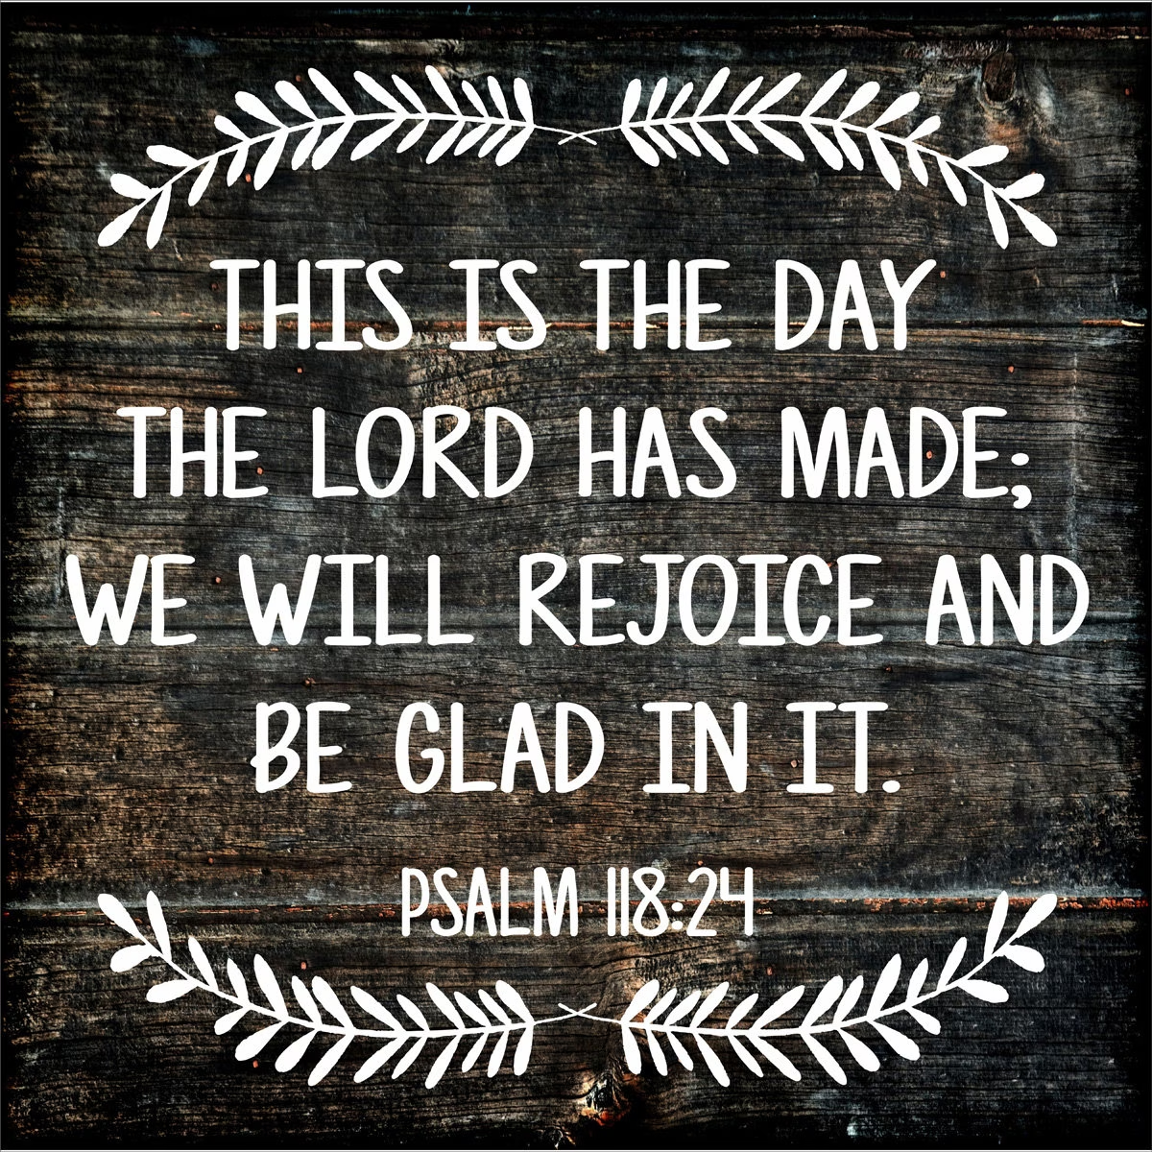
²⁴ The Lord has done it this very day;
let us rejoice today and be glad.
²⁵ Lord, save us!
Lord, grant us success!
²⁶ Blessed is he who comes in the name of the Lord. From the house of the Lord we bless you.
²⁷ The Lord is God, and he has made his light shine on us.
With boughs in hand, join in the festal procession up to the horns of the altar.
²⁸ You are my God, and I will praise you;
you are my God, and I will exalt you.
²⁹ Give thanks to the Lord, for he is good;
his love endures forever.
Notes:
This is all about our living, real God who saves us.
See how many times he names the LORD.
Now see these as the promise Jesus took to the cross
¹⁷ I will not die but live,
and will proclaim what the Lord has done.
²² The stone the builders rejected
has become the cornerstone;
²³ the Lord has done this,
and it is marvellous in our eyes.
Jesus carried to the cross the knowledge of his relationship with the living God who would not let him go, so we can do the same.

