Slide 1
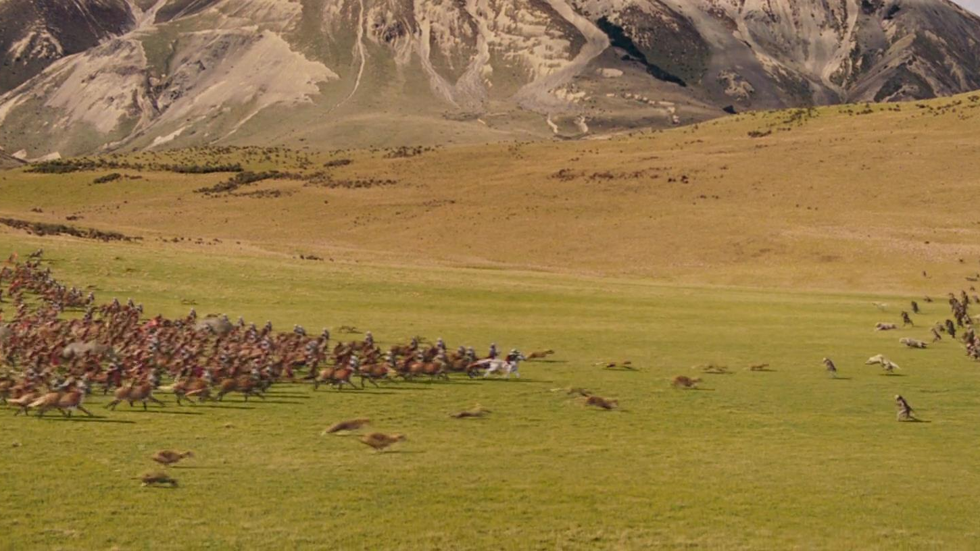
Responding to the battle cry
26th Feb 2023

Slide 2
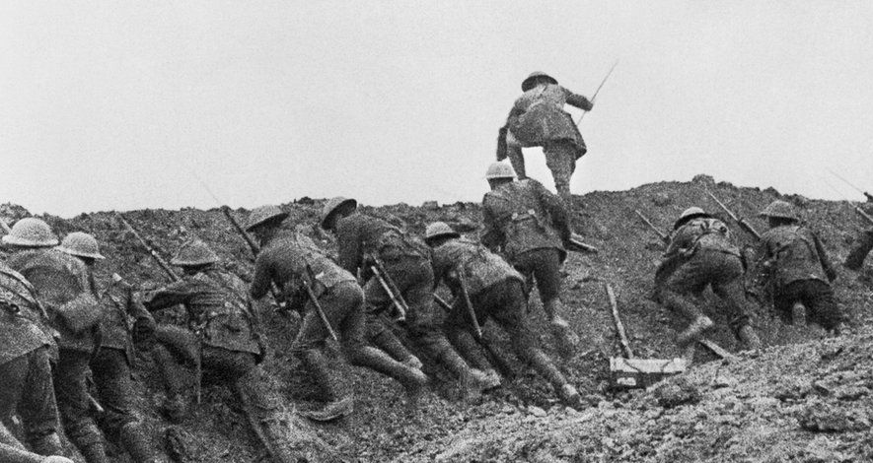



Households Together with Christ at the Centre
The Battle Cry
Sunday 29th January
Sunday 5th February
Sharper Witness
Ministering the Spirit
19th February 2023
Sunday 12th February

Slide 3
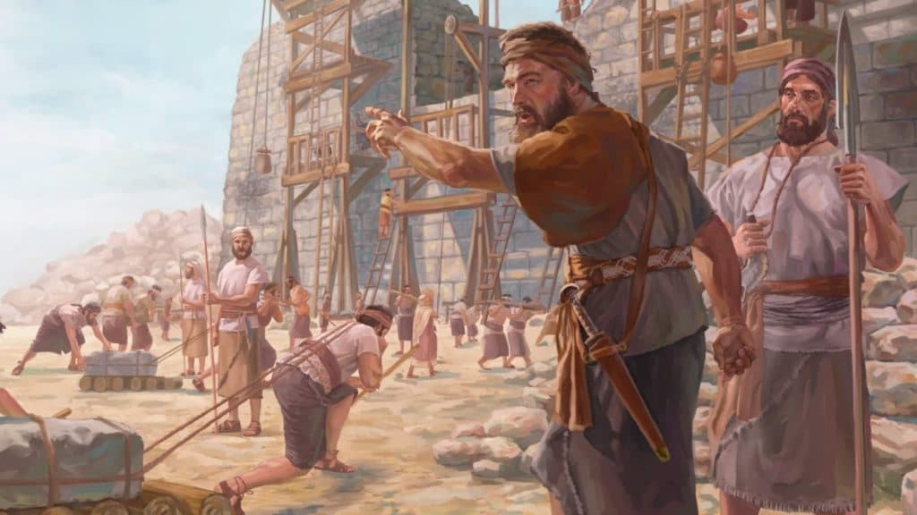
Our Great Project

Slide 4
Our Great Project
Households together with Christ at the centre
Ministering the Spirit
Sharper witness

Slide 5
Our Great Project
Households together with Christ at the centre
  Parents will be released from sense of failure & embrace their God-given call to lead family
  Households comprise of individuals/families of different backgrounds & stages of life where new people quickly belong
  Households will be a consistent place where we experience His presence & get equipped for reaching out

Slide 6
Our Great Project
2. Ministering the Spirit
  Naturally operating in supernatural gifts which
    strengthen the church
    awaken a hunger in the lost
  Increased of awareness & submission to the Spirit
  Able to show not just describe God
  The Spirit enables us to believe God’s promises
  New authority from realising the Spirit within is breaking out

Slide 7
Our Great Project
3. Sharper Witness
  Have to explain the ‘source of our power’ to remain relevant.

Slide 8
How might these messages apply in your life?

Slide 9
What have you heard?

Slide 11
What can I do in response to the battle cry?
Yes, Lord!
Ask God, “What would you have me do?”
Do it
Notes:
“Yes, Lord” – I’ll discover how on the way! (Don’t share because don’t know what to say…)
Willing to sacrifice – Tanya more important that waitress knows God loves her than for Tanya to look dignified

