Slide 1
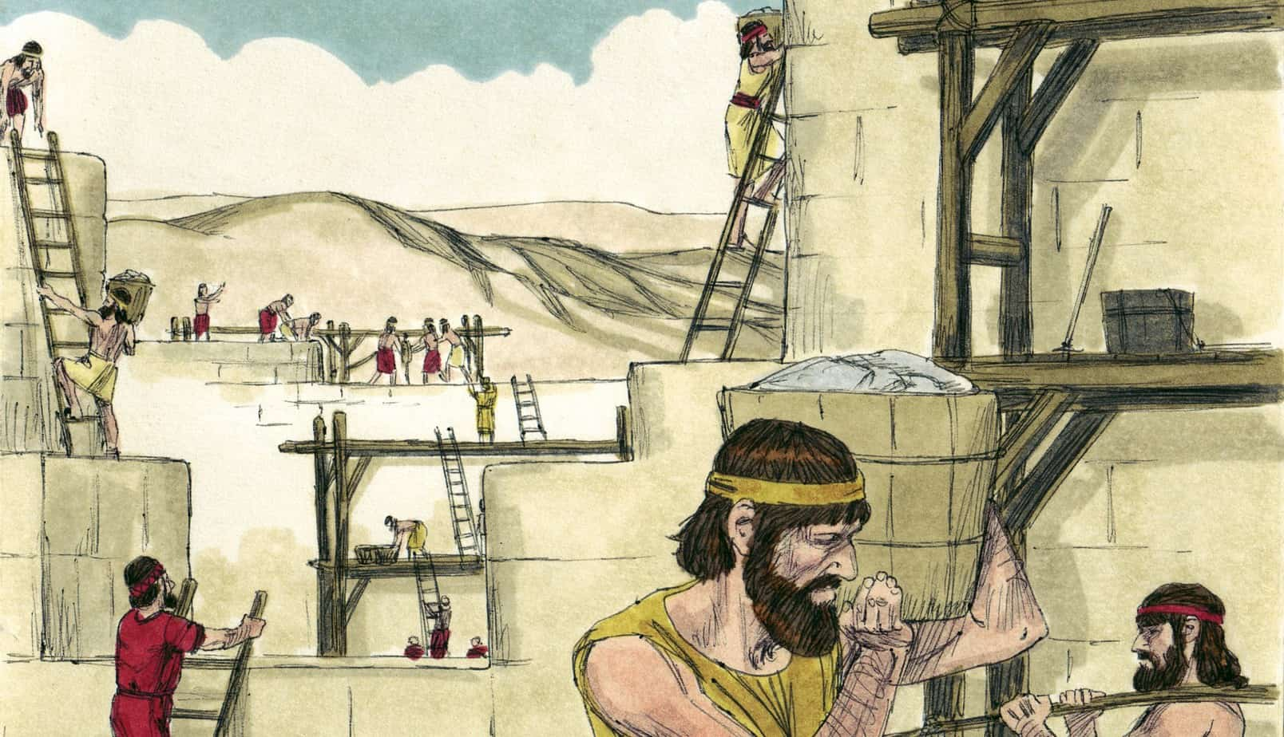
Responding to the Battle Cry Part 2
5th March 2023

Slide 2
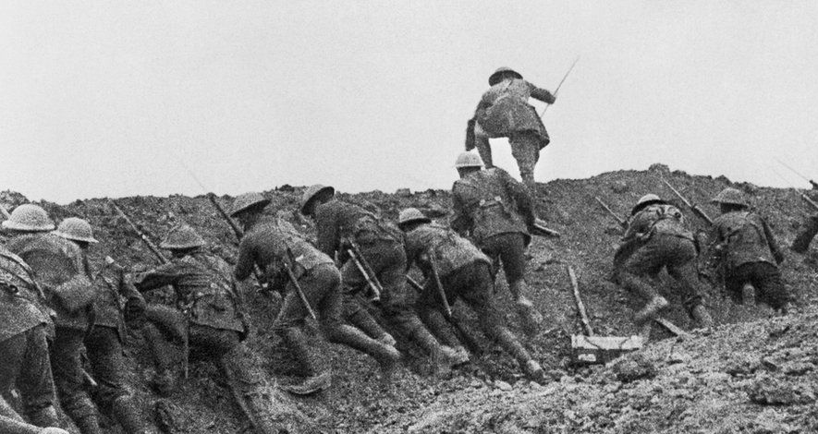

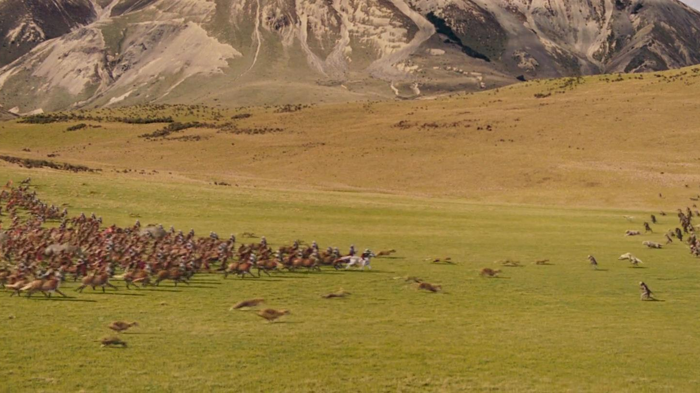


Households Together with Christ at the Centre
The Battle Cry
Sunday 29th January
Sunday 5th February
Responding to the battle cry
Sharper Witness
Ministering the Spirit
26th Feb 2023
19th February 2023
Sunday 12th February

Slide 3
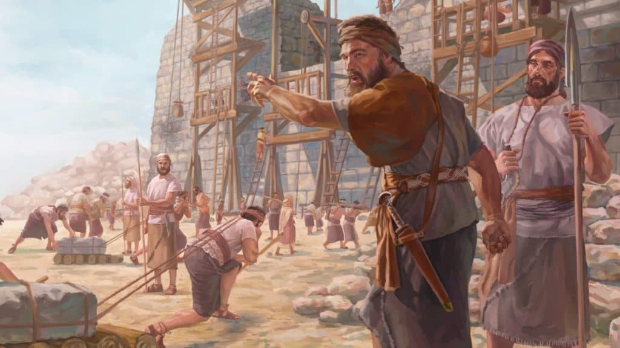
Our Great Project

Slide 4
Our Great Project
Households together with Christ at the centre
Ministering the Spirit
Sharper witness

Slide 5
How might these messages apply in your life?

Slide 6
What have you heard?

Slide 7
What can I do in response to the battle cry?
Yes, Lord!
Ask God, “What would you have me do?”
Do it
Notes:
“Yes, Lord” – I’ll discover how on the way! (Don’t share because don’t know what to say…)
Willing to sacrifice – Tanya more important that waitress knows God loves her than for Tanya to look dignified

