Slide 1

Sharper Witness
19th February 2023

Slide 2
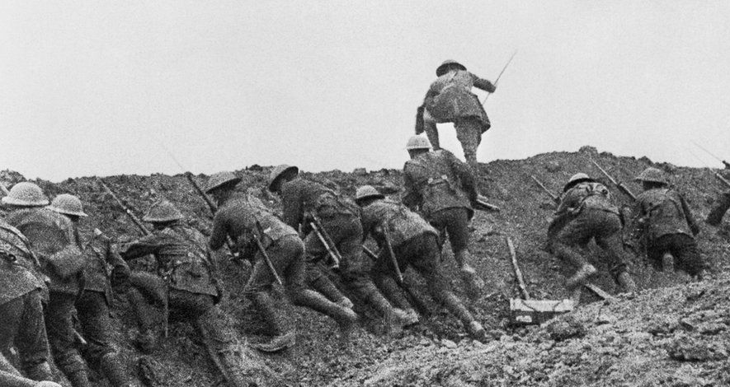


Households Together with Christ at the Centre
The Battle Cry
Sunday 29th January
Sunday 5th February
Ministering the Spirit
Sunday 12th February
5th February 2023

Slide 3
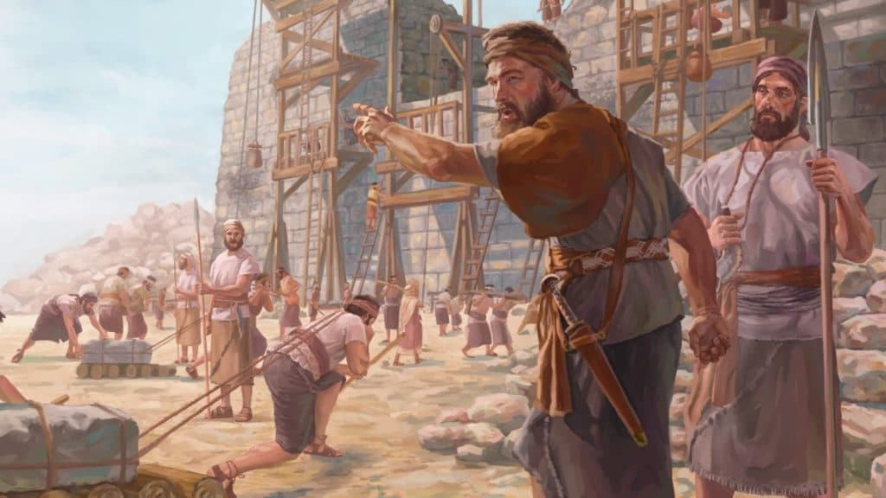
Our Great Project

Slide 4
Our Great Project
Households together with Christ at the centre
Ministering the Spirit
Sharper witness

Slide 5
Defining
Sharper Witness
We will be forced to reveal the ‘source of our power’ to remain relevant.

Slide 6
Sharper Witness
We will be forced to reveal the ‘source of our power’ to remain relevant.
  Revealing the source of my power
“I cannot do it…but God will give Pharaoh the answer he desires.”
- Gen 41:16
Daniel replied, “No wise man, enchanter, magician or diviner can explain to the king the mystery he has asked about, but there is a God in heaven who reveals mysteries…
- Daniel 2:27-28
…‘Not by might nor by power, but by my Spirit,’ says the LORD Almighty.
- Zech 4:6
…In the name of Jesus Christ of Nazareth, walk
- Acts 3:6

Slide 7
Sharper Witness
We will be forced to reveal the ‘source of our power’ to remain relevant.
  Remaining relevant
    Esther exposed
      For if you remain silent at this time, relief and deliverance for the Jews will arise from another place, but you and your father’s family will perish. And who knows but that you have come to your royal position for such a time as this?” (Esth 4:14)
    E.g. Boss bore blame
    E.g. medical mystery
Notes:
We become irrelevant when we aren’t willing to answer the questions being asked.
Esther – if she doesn’t take opportunity in front of her, God will use someone else – though she is in the palace (place of influence) it means nothing if not willing to make use of it
E.g. public health asks
Public health: how is it that Mrs X has got better since she has been involved in your community where all the medical interventions we prescribed seem to have done nothing?
Us: We are just an inclusive bunch
Public health: No, really, what is your secret?
Us: We know a God who was so committed to including us that He laid down His privilege, came down to earth to live as one of us and because He was excluded to the point of the execution that He bought us into His family for eternity. This same God is calling and enabling me to lay down my life so that I can include others because He loves and values them.

Slide 8
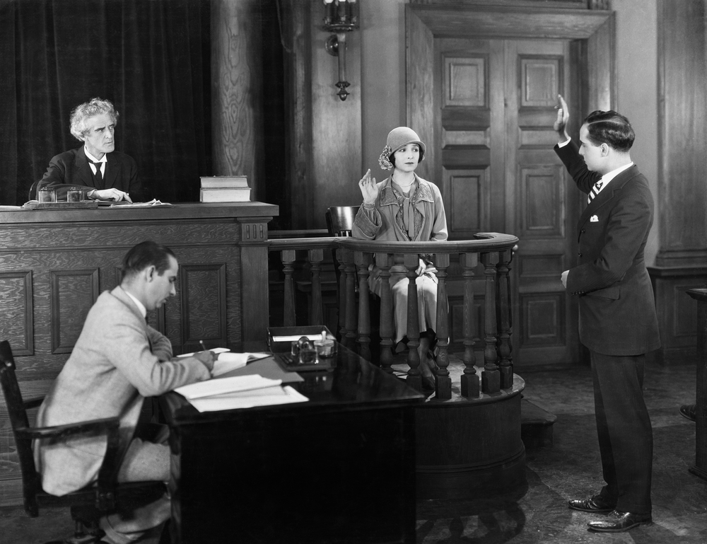
How do I sharpen my witness?
Be faithful to what you have witnessed (in words and deeds)
Notes:
A witness is only called upon if they have witnessed (seen/experienced) something – what have you witnessed?
You have to be faithful to what you have witnessed – not down to how you feel about what you have seen
If you aren’t willing to be honest about what you have seen you won’t be call upon
Expect that your testimony will contain info which others haven’t seen yet – otherwise you aren’t needed as a witness
Matt 5:16
In the same way, let your light shine before others, that they may see your good deeds and glorify your Father in heaven.

Slide 9
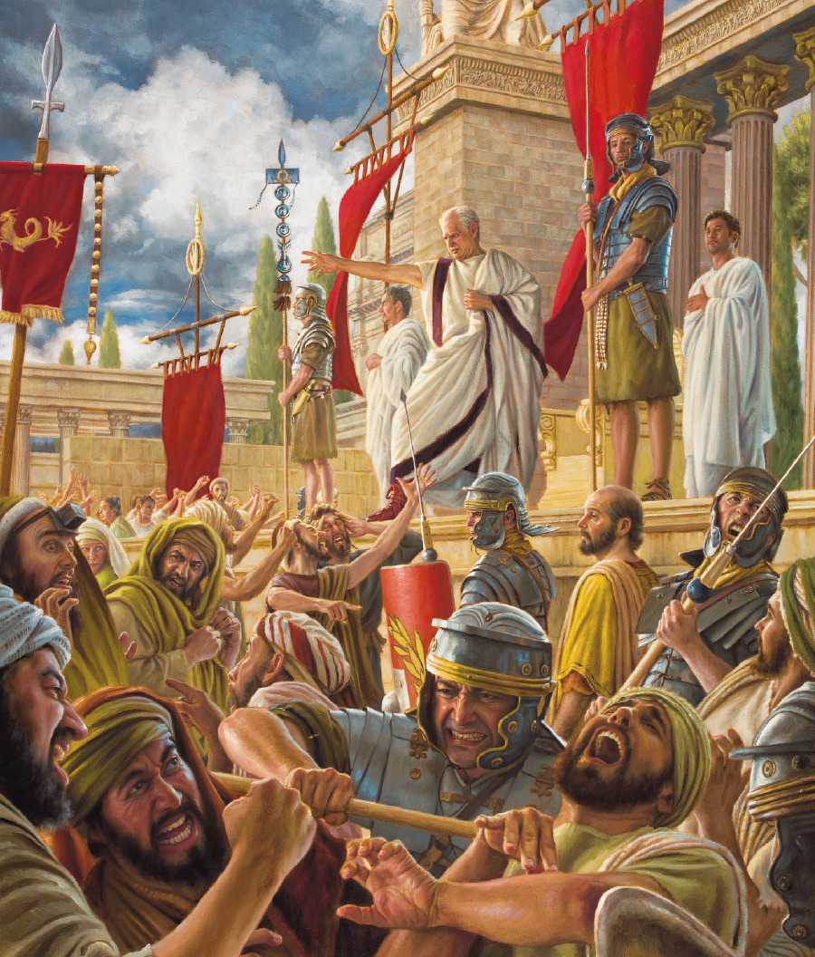
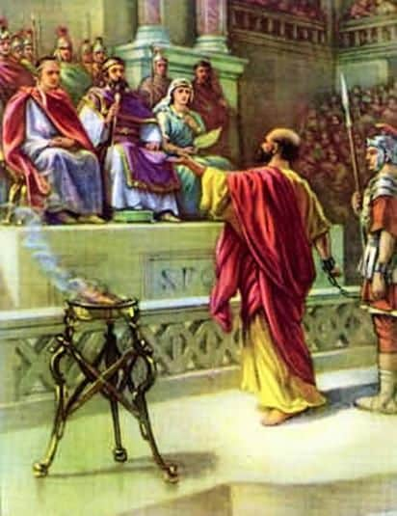
How do I sharpen my witness?
Be ready to tell your story
…Always be prepared to give an answer to everyone who asks you to give the reason for the hope that you have. But do this with gentleness and respect (1 Pet 3:15)
But when they arrest you, do not worry about what to say or how to say it. At that time you will be given what to say, for it will not be you speaking, but the Spirit of your Father speaking through you. (Matt 10:19)
Notes:
Paul tells his story
To the hostile crowd – Acts 22:5-14
To Festus & King Agrippa – Acts 26:9-18
Can you tell your story in 60 secs? Before, what happened, how changed?
Leave the door ajar – allowing someone to push on it (bait/testing the water)
Alert for every opportunity – never know who God is drawing towards Him – eager to participate
e.g. flat tyre - inconvenience to opportunity
e.g. Nick & JW @ shop
Don’t worry too much about what you will say (can’t be prepared for every opportunity)
John Guido – just name the name of Jesus
Matt 10:19 But when they arrest you, do not worry about what to say or how to say it. At that time you will be given what to say, for it will not be you speaking, but the Spirit of your Father speaking through you.

Slide 10
How do I sharpen my witness?
Enjoy your message
Restore to me the joy of your salvation and grant me a willing spirit, to sustain me.
- Ps 51:12
“You have all you need to live life successfully in your account given by the sacrifice of Jesus!”
Notes:
Even God is pleased with the message (1 Cor 1:21)

Slide 11
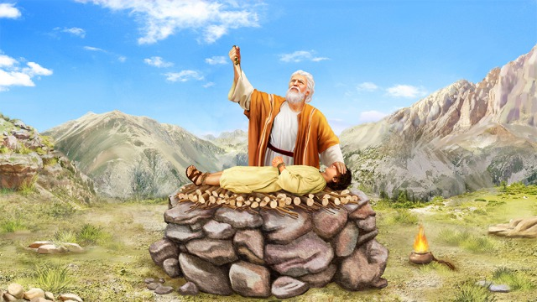
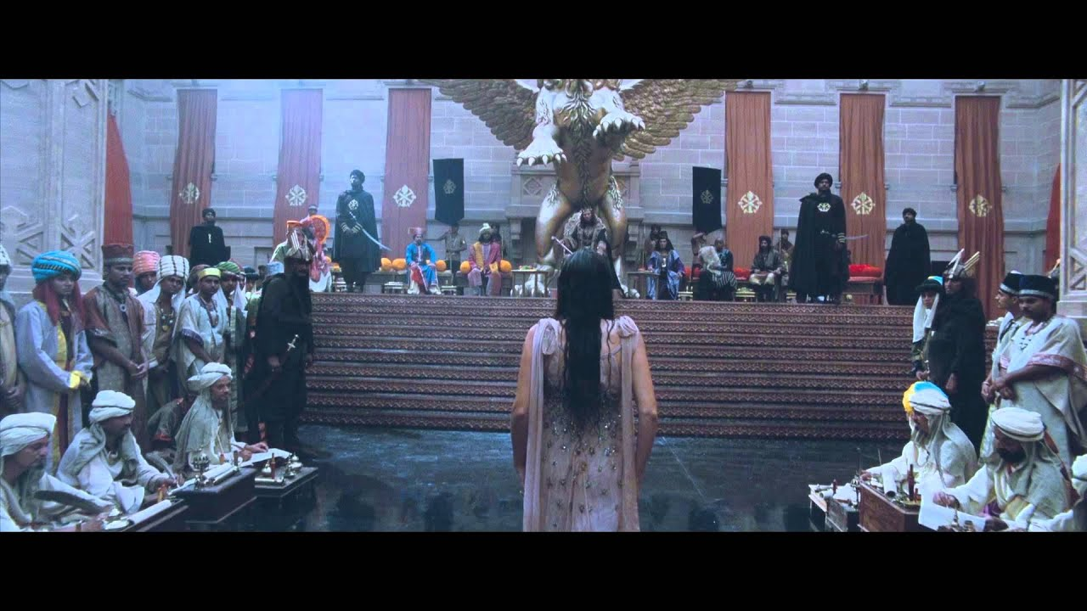
How do I sharpen my witness?
Willing to sacrifice your platform
Notes:
Abraham willing to give up the promised child
Esther willing to give up the palace/her life
- Esther might have thought she had got to her place of influence (queen) by playing by the rules, including keeping her identity a secret (2:10). But the season changed and to participate in the next stage of God’s plan she had to ‘out’ her identity. It was threatening. Like Abraham having to lay Isaac (the promise) on the altar.
If not willing to give back that which you believe God has given to you will blunt your witness
Your platform becomes an idol (a good thing which has become the ultimate thing)
What is your platform?
- Your relationship, job/career (maybe risk these things but most likely its our) respectability

Slide 12

Revealing the source of your power
Notes:
Pulling back the curtain – (a moment of opportunity in which we decide to duck or dive in) to be more overt about the source of our power. We will be asked more direct questions. It is us who will have to get over our own awkwardness about giving
Not enough to just talk ‘principles’ or be in the palace. Compelled to share the Source.
We become irrelevant when we aren’t willing to answer the questions being asked.
a direct response.

Slide 13

How do I sharpen my witness?
Increased awareness of what He’s up to

Slide 14
How do I sharpen my witness?
Increased awareness of what He’s up to
I would have despaired unless I had believed that I would see the goodness of the LORD In the land of the living.
- Ps27:13
Notes:
Ps 27:13 believed to see…
Previously overwhelmed by the need – now see God in it
God is at work in every human heart (whether we see it or not)
Even when I don't see it, You're working
Even when I don't feel it, You're working
You never stop, You never stop working
You never stop, You never stop working

Slide 15

How do I sharpen my witness?
Increased awareness of what He’s up to
“Behold the Lamb…” (John 1:29)
- John the Baptist
“Look, I see heaven open and the Son of Man standing at the right hand of God.” (Acts 7:56) - Stephen
“Just say what you see”
“I saw the Lord” (Isa 6:1)
- Isaiah
I saw the love God had for waitress
- Tanya

Slide 16
Naming the name of Jesus
Why is it easier to talk about ‘God’ than ‘Jesus’?

Slide 17

Power in the name of Jesus
Jesus gives ‘God’ definition
  Col 1:15
    The Son is the image of the invisible God, the firstborn over all creation.
  John 1:1,14
    In the beginning was the Word, and the Word was with God, and the Word was God.
    The Word became flesh and made his dwelling among us…
  Col 2:9
  For in Christ all the fullness of the Deity lives in bodily form
  Heb 1:3
    The Son is the radiance of God’s glory and the exact representation of his being, sustaining all things by his powerful word.
Notes:
The corrupt human heart want to create a ‘god’ of our own design. This ‘god’ has a tendency to agree with our opinions and doesn’t require anything of us which we don’t already want to do.
My ‘god’ is ok with sin, my ‘god’ is distant and disengaged in this world, my ‘god’ has given up on humanity
Jesus was a historical figure. He walked this earth. (Bart Ehrman (critic of Christianity) “It is striking that virtually everyone who has spent all the years needed to attain these qualifications [learning ancient language and studying facts] is convinced that Jesus of Nazareth was a real historical figure.“)
People hate Jesus and the cross because it forces us to recognise this man died because of my sin. It shows that God hates sin – ‘righteous = another defining attribute of Him. Jesus provides us with a defined God which removes the chances for us to create a God of our own image. Its not the ‘-ian’ in ‘Christian’ or the ‘follower of –’ in the ‘follower of Christ’ which annoys people, it is the ‘Christ’.

Slide 18
Power in the name of Jesus
No other name
  Acts 4:12
  And there is salvation in no one else, for there is no other name under heaven given among men by which we must be saved.”
  Rom 10:13-14
  for, “Everyone who calls on the name of the Lord will be saved.” How, then, can they call on the one they have not believed in? And how can they believe in the one of whom they have not heard? And how can they hear without someone preaching to them?
  Phil 2:9-11
    …gave him the name that is above every name, that at the name of Jesus every knee should bow
Notes:
The power people need to believe the truth is wrapped up in our declaration of the truth – if we don’t speak it, people can’t believe it (Rom 10:14)
Instead of waiting until someone seems ready to believe, the very faith to believe is held within the declaration of that truth
Phil 2:9-11
Therefore God exalted him to the highest place
and gave him the name that is above every name,
¹⁰ that at the name of Jesus every knee should bow,
in heaven and on earth and under the earth,
¹¹ and every tongue acknowledge that Jesus Christ is Lord,
to the glory of God the Father.
God has made Jesus Lord of all – so my reception of Jesus (i.e. if I surrender the rule of my life) is key to my salvation

Slide 19
Power in the name of Jesus
The offense of Jesus
For Christ did not send me to baptize, but to preach the gospel—not with wisdom and eloquence, lest the cross of Christ be emptied of its power.
For the message of the cross is foolishness to those who are perishing, but to us who are being saved it is the power of God. For it is written:
“I will destroy the wisdom of the wise; the intelligence of the intelligent I will frustrate.”
Where is the wise person? Where is the teacher of the law? Where is the philosopher of this age? Has not God made foolish the wisdom of the world? For since in the wisdom of God the world through its wisdom did not know him, God was pleased through the foolishness of what was preached to save those who believe. Jews demand signs and Greeks look for wisdom, but we preach Christ crucified: a stumbling block to Jews and foolishness to Gentiles, but to those whom God has called, both Jews and Greeks, Christ the power of God and the wisdom of God. (1 Cor 1:17-24)
Notes:
It’s not just that people have negative ideas towards our message/messengers or we don’t explain it properly but God actually designed the message so we wouldn’t be able to access it through human logic. The message is designed to (a) cause salvation, (b) seem foolish or (c) invoke rejection.
Like with the soil parable the response we take to the message depends on our heart.
Real way to find God is to humble our arrogant selves.
Jesus demonstrated that He wasn’t interested in making the gospel easy to swallow and intellectually stimulating. He did the opposite to what we would he raised the cost (e.g. told His audience to ‘drink my blood’ and lost His crowd) and he lowered the advertising (e.g. don’t tell anyone that I’ve healed you).
We can be confident some will reject the message – this isn’t necessarily our fault – we are trying to re-present Jesus. No one presented a better image of Jesus than Jesus and they rejected and crucified Him.
We can’t make God seem nicer or easier to get to than He Himself chooses. He doesn’t ask us to be lawyer but witnesses. Not my job to defend God’s ways.

Slide 20
What can I do in response to the battle cry regarding a sharper witness?
Yes, Lord!
Be on the lookout and ready to speak/act
Fall in love all over again with the message
Willing to sacrifice
Notes:
“Yes, Lord” – I’ll discover how on the way! (Don’t share because don’t know what to say…)
Willing to sacrifice – Tanya more important that waitress knows God loves her than for Tanya to look dignified

