Slide 1
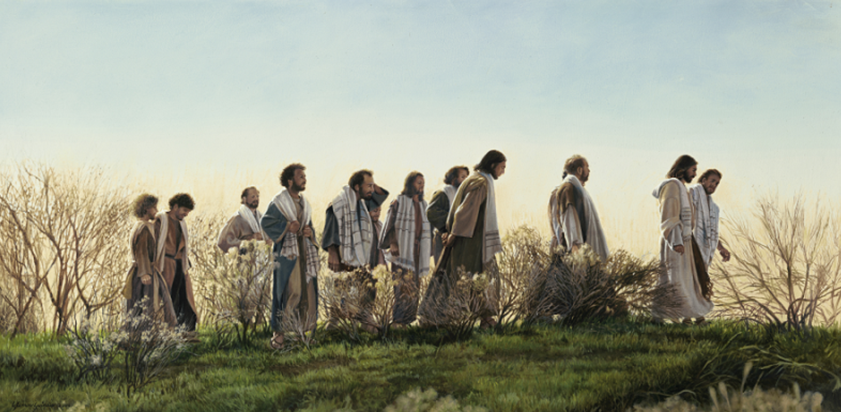
Luke 17 v 11-19

Slide 2
Leviticus 13 v 46
“…they will be ceremonially unclean. They must live in isolation in their place outside the camp.”

Slide 3
“…The following instructions are for those seeking ceremonial purification from a skin disease. Those who have been healed must be brought to the priest.”
Leviticus 14 v 2

Slide 4
“he … came back to Jesus, shouting, “Praise God!” He fell to the ground at Jesus’ feet, thanking him for what he had done.”

Slide 5
“Didn’t I heal ten men? Where are the other nine? … stand up and go. Your faith has healed you.”

Slide 6
1. Thankfulness requires intentionality
2. Thankfulness draws us deeper into relationship with God
3. Thankfulness changes us

Slide 7
1. Thankfulness requires intentionality

Slide 8
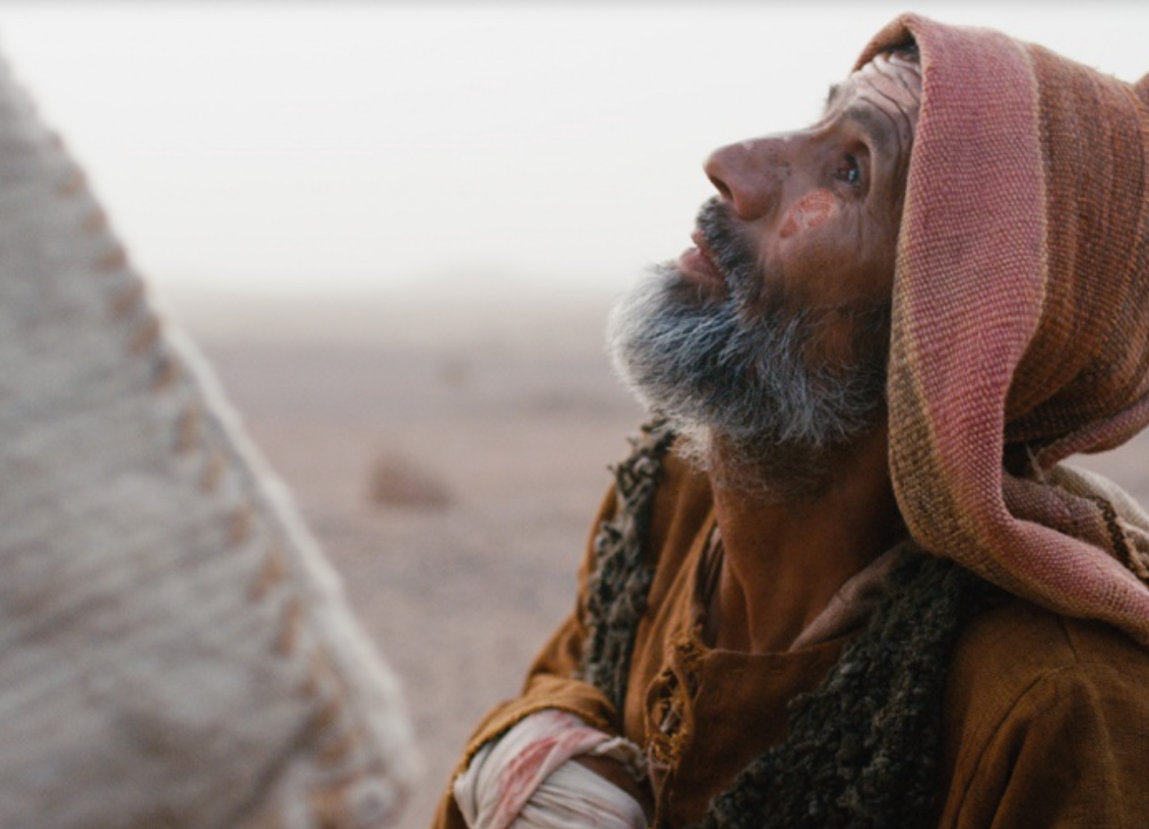
“…then one of them, when he saw that he was healed, came back to Jesus, shouting, ‘Praise God!’”

Slide 9
“May you be filled with joy, always thanking the Father…”
- Colossians 1.11-12
“Be filled with the Spirit … giving thanks always and for everything to God the Father in the name of our Lord Jesus Christ.”
- Ephesians 5.18,20
“And let the peace that comes from Christ rule in your hearts … And always be thankful.”
- Colossians 3.15

Slide 10
“May you be filled with joy, always thanking the Father…”
- Colossians 1.11-12
“Be filled with the Spirit … giving thanks always and for everything to God the Father in the name of our Lord Jesus Christ.”
- Ephesians 5.18,20
“And let the peace that comes from Christ rule in your hearts … And always be thankful.”
- Colossians 3.15

Slide 11
The human brain cannot respond to anxiety and gratitude at the same time…
- Robert Emmons and Michael McCullough, 2004

Slide 12
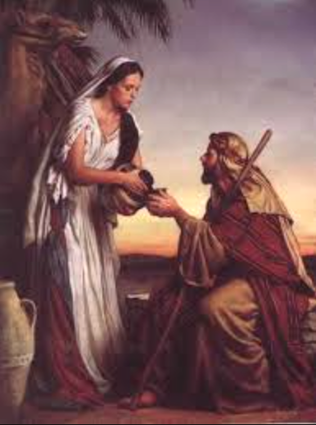
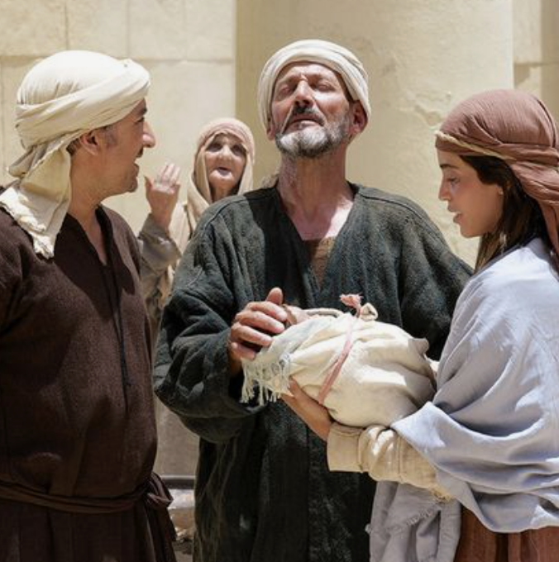
Abraham’s
servant
Mary
“With all my heart I glorify the Lord!
In the depths of who I am I rejoice in God my saviour.”
Simeon

Slide 13
Jesus
“O Father, Lord of heaven and earth, thank you for hiding these things from those who think themselves wise and clever, and for revealing them to the childlike.”

Slide 14
2. Thankfulness draws us deeper into relationship with God

Slide 15
One of them, when he saw that he was healed, came back to Jesus, shouting, ‘Praise God!’ He fell to the ground at Jesus’ feet, thanking him for what he had done.

Slide 16
“…in other words, gratitude helps people realize that they wouldn’t be where they are without the help of others.”
- Robert Emmons

Slide 17
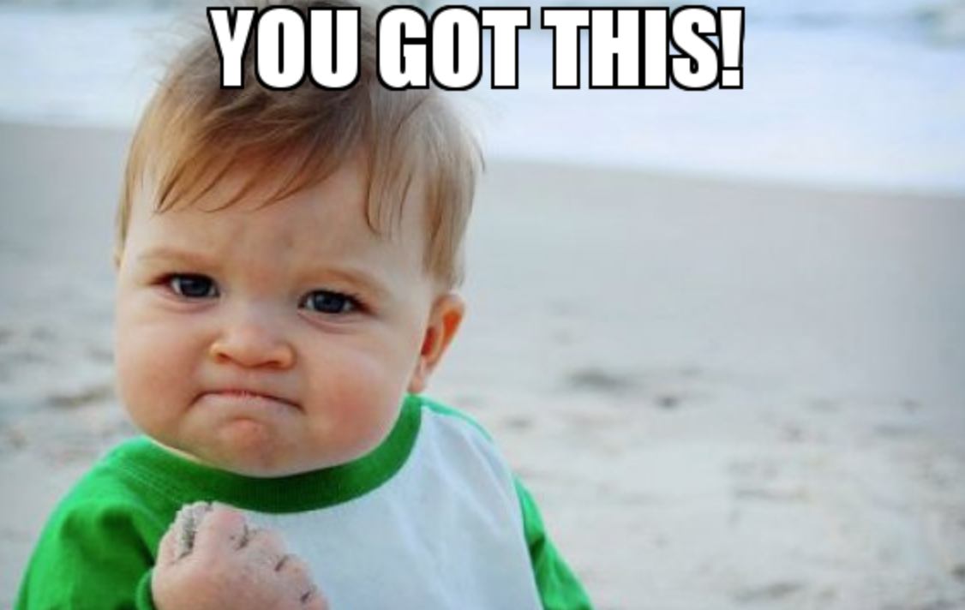
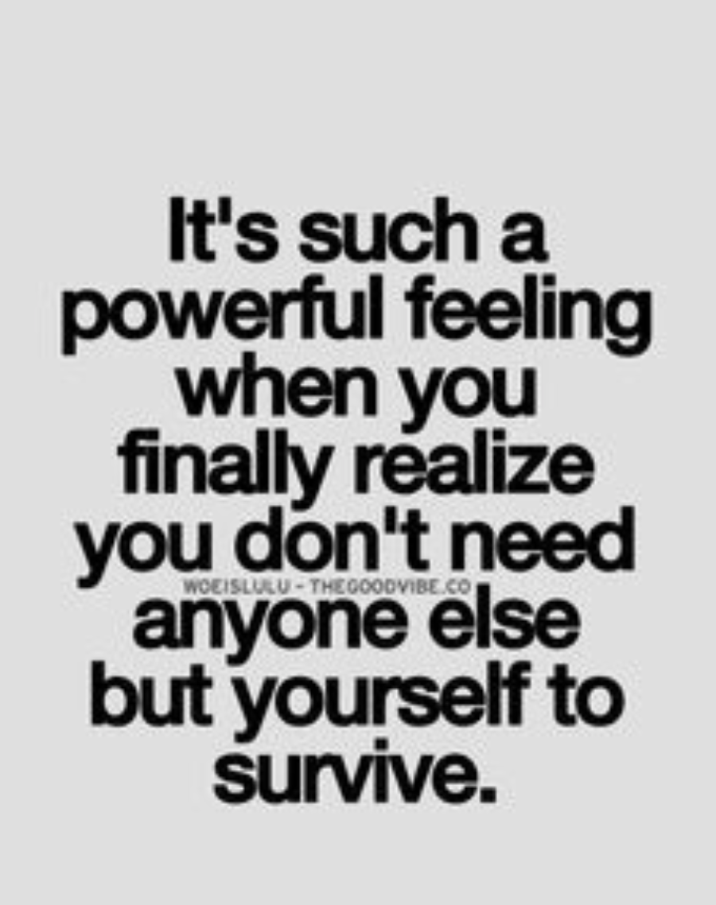
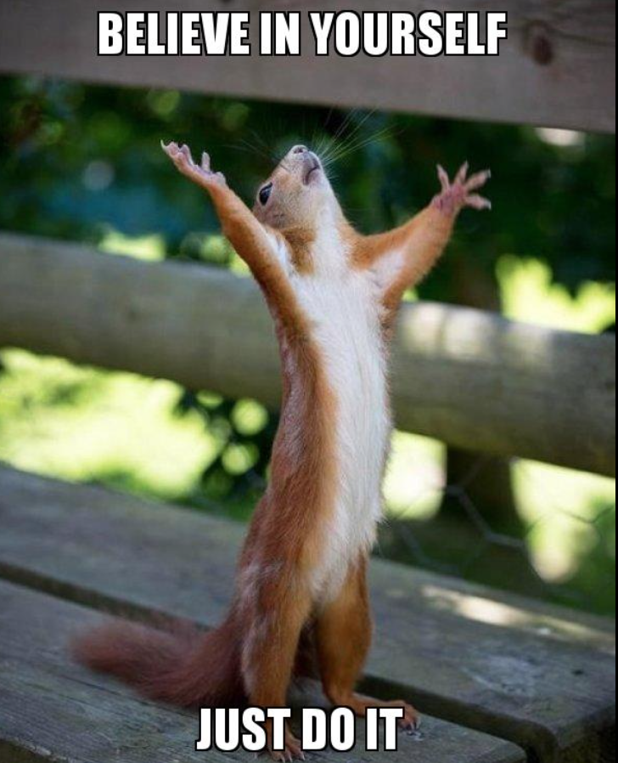

Slide 18
“…then one of them, when he saw that he was healed, came back to Jesus…”

Slide 19
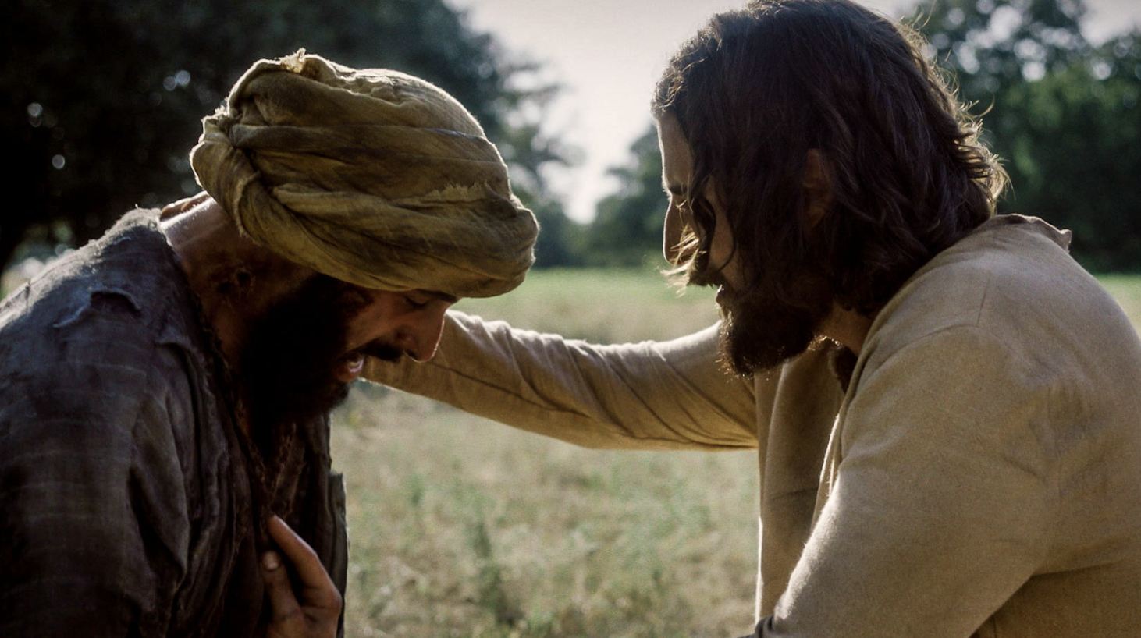
“…he fell to the ground at Jesus’ feet, thanking him…”

Slide 20
3. Thankfulness changes us

Slide 21
“Didn’t I heal ten men? Where are the other nine? Has no one returned to give glory to God except this foreigner? … Stand up and go. Your faith has healed you.”

Slide 22
“Didn’t I heal ten men? Where are the other nine? Has no one returned to give glory to God except this foreigner? … Stand up and go. Your faith has healed you.”

Slide 23
“Didn’t I heal ten men? Where are the other nine? Has no one returned to give glory to God except this foreigner? … Stand up and go. Your faith has healed you.”
katharizo
sozo

Slide 24
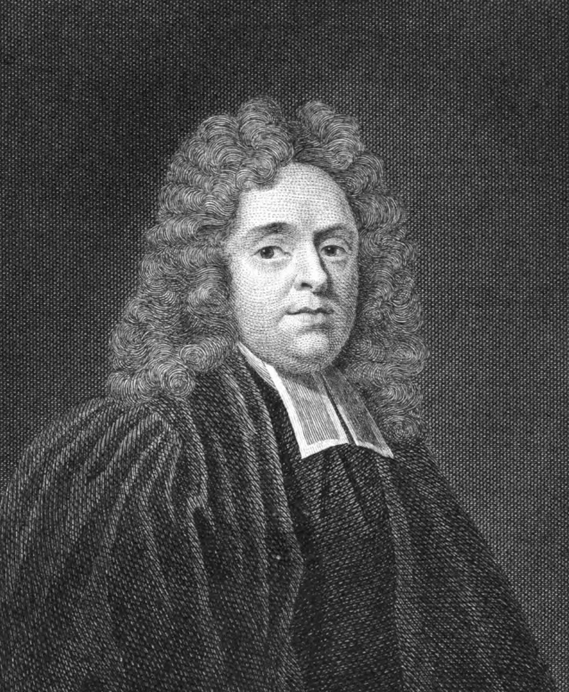
“The others alone got the outward cure, he alone got the spiritual blessing.”
- Matthew Henry

Slide 25
“This was something more than the first healing … A new power was his from that day forth. Closely united to his Master, we may think of the poor unknown Samaritan forever among the friends of Jesus here and in the world to come. There are degrees in grace here … the nine [had faith enough for healing] This one … determined to learn more of his healer.”

Slide 26
“Now this is eternal life: that they know you, the only true God, and Jesus Christ, whom you have sent.”
- John 17 v. 3

Slide 27
“Now this is eternal life: that they know you, the only true God, and Jesus Christ, whom you have sent.”
- John 17 v. 3

Slide 28
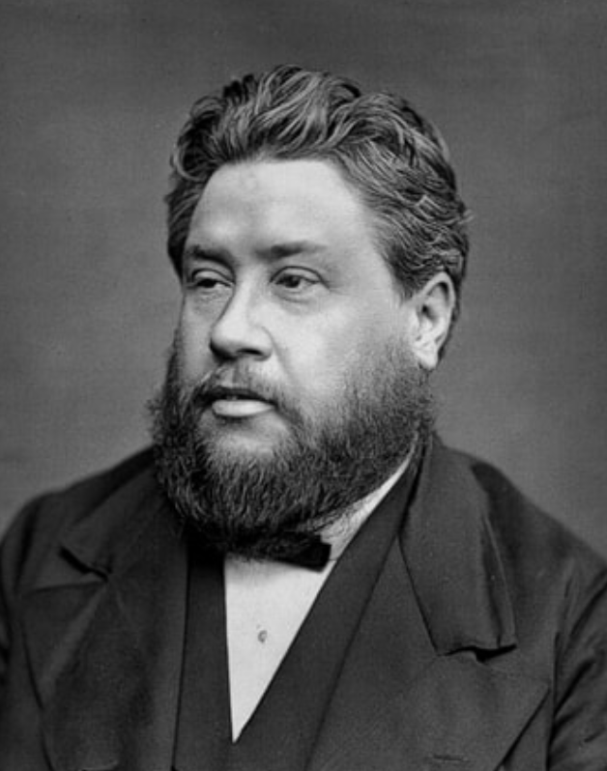
“All ten were willing to do a religious ceremony … Only one was filled with true praise and thanksgiving. External religious exercises are easy enough, and common enough; but the internal matter, the drawing out of the heart in thankful love, how scarce a thing it is!”
- Charles Spurgeon

Slide 29
Good news:
This isn’t about trying harder…

Slide 30
May you be filled with joy, always thanking the Father. He has enabled you to share in the inheritance that belongs to his people, who live in the light. For he has rescued us from the kingdom of darkness and transferred us into the Kingdom of his dear Son, who purchased our freedom and forgave our sins.
- Colossians 1.11-16

Slide 31
1. “Lord, I’m ready to take a practical step toward thankfulness."
2. “Help me cultivate a thankful heart in the midst of uncertainty … anxiety.”
3. “Lord, I want to respond to what you’ve done for me on the cross. To be rooted in this reality above all others.”

