Slide 1

Battle Cry:
Them’s Fightin’ Words
19th March 2023

Slide 2
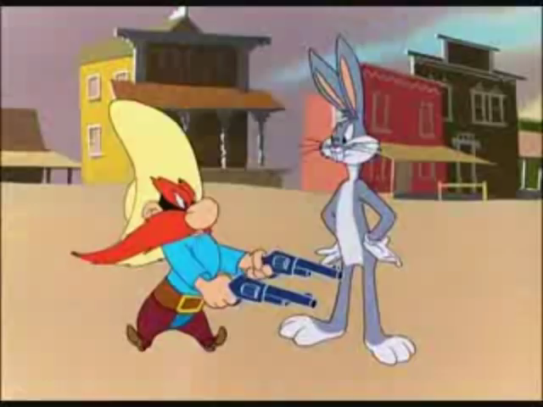
Them’s Fightin’ Words
Notes:
Other fightin’ words
“Give me this hill country” Caleb
“chose for yourself who you will serve, as for me and my household, we will serve the Lord” Joshua
“I’ll cut off your head. …and the whole world will know that there is a God in Israel.” David
“I will set my face like flint” Isaiah
“Our God can save us, but even if He doesn’t, we won’t bow down to your idol” Meshack, Shadrack, Abenego
“If I perish, I perish” Esther
“Take this cup from me, but your will, not mine, be done” Jesus
Rev 12:11 They triumphed over him [satan] by the blood of the Lamb and by the word of their testimony; they did not love their lives so much as to shrink from death.

Slide 3
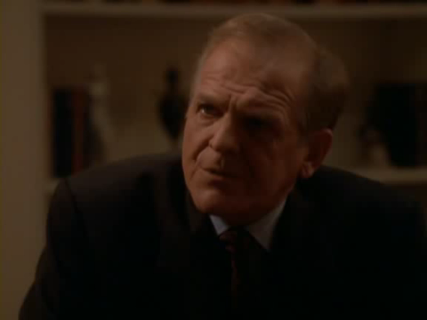
Them’s Fightin’ Words
“If we are going to walk into walls, I want us running into them full speed”
“We are going to lose some of these battles, and we may even lose the White House, but we aren’t going to be threatened by issues, we are going to put them front and centre. We are going to raise the level of public debate in this country.”
- Leo McGarry
Notes:
We need fighting words/mentality to pursue what He is calling us to (to Him and to His work)
Last week JWS “I want to invite you to ask God to set an enduring passion in your hearts for the vision.”
Vision birthed in the heart has motivational force – we still have a role to partner/collaborate
unwavering determination
I believe God is calling us to a purer devotion to Him. I believe in these days He is making Himself known and as a result we are hooked. He wants to become more desirous to us than life itself. In comparison to Him, all else will become dim. I believe as we make Him the prize, then all other options begin losing their appeal, and He becomes more appealing. He is worth shedding everything else for.

Slide 4
Today we will explore…
Jesus is the prize
We were made for so much more
What if Jesus was the end in Himself?

Slide 5
1. Jesus is the Prize

Slide 6
(Phil 3:7-14) ⁷ But whatever were gains to me I now consider loss for the sake of Christ. ⁸ What is more, I consider everything a loss because of the surpassing worth of knowing Christ Jesus my Lord, for whose sake I have lost all things. I consider them garbage, that I may gain Christ ⁹ and be found in him, not having a righteousness of my own that comes from the law, but that which is through faith in Christ—the righteousness that comes from God on the basis of faith. ¹⁰ I want to know Christ—yes, to know the power of his resurrection and participation in his sufferings, becoming like him in his death, ¹¹ and so, somehow, attaining to the resurrection from the dead.
¹² Not that I have already obtained all this, or have already arrived at my goal, but I press on to take hold of that for which Christ Jesus took hold of me. ¹³ Brothers and sisters, I do not consider myself yet to have taken hold of it. But one thing I do: Forgetting what is behind and straining toward what is ahead, ¹⁴ I press on toward the goal to win the prize for which God has called me heavenward in Christ Jesus.

Slide 7
Jesus is the prize
…surpassing worth of knowing Christ…
I want to know Christ…
(Phil 3:8,10)
…him who is able to do immeasurably more than all we ask or imagine… (Eph 3:20)
One thing I have asked of the LORD; this is what I desire: to dwell in the house of the LORD all the days of my life, to gaze on the beauty of the LORD and seek Him in His temple. (Psalm 27:4)
..to live is Christ and to die is gain..
…I desire to depart and be with Christ… (Phil 1:21,23)
Were the whole realm of nature mine,
that were a present far too small.
Love so amazing, so divine,
demands my soul, my life, my all.
"Come, all you who are thirsty, come to the waters; and you without money, come, buy, and eat! (Isaiah 55:1)
Better is one day in your courts, than a thousand elsewhere (Ps 84:10)
Notes:
These guys have seen something of Him which has grabs their devotion. We need Him to show Himself that we may fall in love
Phil 1:20-24
I eagerly expect and hope that I will in no way be ashamed, but will have sufficient courage so that now as always Christ will be exalted in my body, whether by life or by death. 21For to me, to live is Christ and to die is gain. 22If I am to go on living in the body, this will mean fruitful labor for me. Yet what shall I choose? I do not know! 23I am torn between the two: I desire to depart and be with Christ, which is better by far; 24but it is more necessary for you that I remain in the body.
Ps 42:1
As the deer pants for streams of water, so my soul pants for you, my God.
1 John 3:1
See what great love the Father has lavished on us, that we should be called children of God! And that is what we are!

Slide 8
2. We were made for so much more

Slide 9
2) We were made for so much more
Just passing through
  Jesus knew that…he had come from God and was returning to God (John 13:3)
  foreigners and strangers (Heb 11:13, 1 Peter 2:11)
  In the world but not of it (John 17:14-15)
  Heart set on pilgrimage (Ps84:5)
  Citizen of heaven (Phil 3:19-20)
Notes:
JWS just passing through – Table Mountain
As they pass through the Valley of Baca

Slide 10
2) We were made for so much more
We are on a mission
  We are therefore Christ’s ambassadors, as though God were making his appeal through us. We implore you on Christ’s behalf: Be reconciled to God. (2 Cor 5:20)
  No one serving as a soldier gets entangled in civilian affairs, but rather tries to please his commanding officer. (2 Tim 2:4)
Notes:
Matt 25:23 “His master replied, ‘Well done, good and faithful servant! You have been faithful with a few things; I will put you in charge of many things. Come and share your master’s happinesss!’
Focus, responsibility, a greater purpose, I’m here for someone else’s benefit

Slide 11
2) We were made for so much more
Designed for the eternal
Matt 6:19-21
“Do not store up for yourselves treasures on earth, where moths and vermin destroy, and where thieves break in and steal. But store up for yourselves treasures in heaven, where moths and vermin do not destroy, and where thieves do not break in and steal. For where your treasure is, there your heart will be also.
Luke 23:43
Jesus answered him, “Truly I tell you, today you will be with me in paradise.”
“He has eternality to make it up to me”
Notes:
You have never met a mere mortal – CS Lewis
Col 3:1-3 – set your heart and mind on things above (not earthly) – above = eternal things
He has also set eternity in the human heart (Eccl 3:11) – no wonder nothing else fits/satisfies

Slide 12
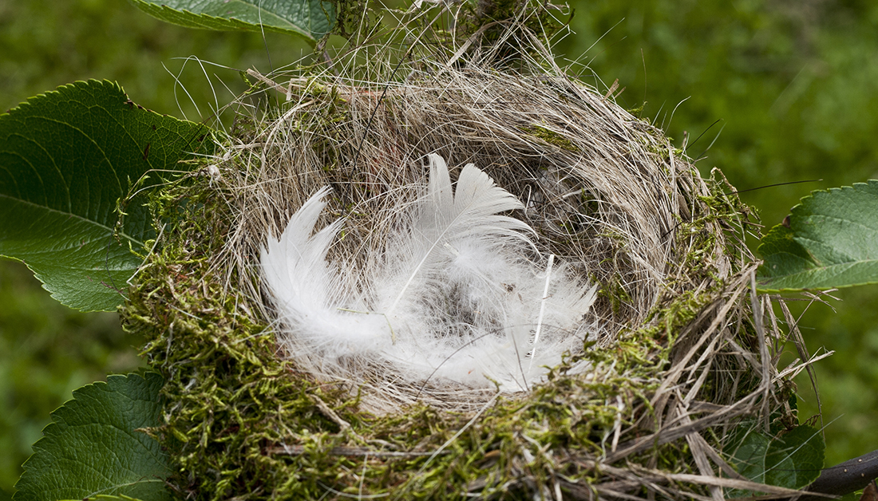
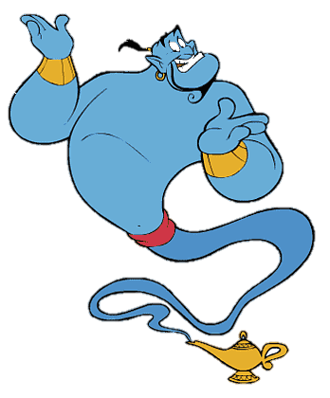
2) We were made for so much more
More than feathering own nest
Notes:
Is God here to fulfil my wish or am I here to fulfil His wish?
I realise I’m using God when I get disappointed – “I trusted you but…”

Slide 13
2) We were made for so much more
More than feathering own nest
“Therefore I tell you, do not worry about your life, what you will eat or drink; or about your body, what you will wear. Is not life more than food, and the body more than clothes?
- Matt 6:25
Is not life more than …[Insert idol here]…?
Marriage
Family
Friendship
Career
Pass-time
Notes:
Idol = good thing which has become ultimate thing – taking God’s rightful place
Marriage - to attain to that age and to the resurrection from the dead neither marry nor are given in marriage, for they cannot die anymore, because they are equal to angels and are sons of God, being sons of the resurrection.” (Luke 20:34-36)
Friendship - C.S. Lewis, The Four Loves
That is why those pathetic people who simply ‘want friends’ can never make any. The very condition of having Friends is that we should want something else besides Friends.
Friendship must be about something
The typical expression of opening Friendship would be something like, "What? You too? I thought I was the only one.“
Vista
I was made for more than this (feathering my own nest, pushed around by world’s priorities).
I have been set free and commissioned to be part of creations jailbreak.
“We were meant to live for so much more
Have we lost ourselves?
We want more than this world's got to offer”
Jesus not a means to an end – don’t use him to get security. He is security
Tim Keller – education/missionary

Slide 14
3. What if…Jesus was the end in Himself?

Slide 15

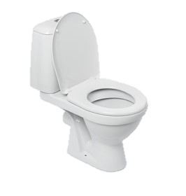

3) What if Jesus was the end in Himself?
A better ‘yes’
Notes:
If I can see Him for all He is – that He is who He says He is – why would I go anywhere else?
Not just eliminating the negative

Slide 16
3) What if Jesus was the end in Himself?
I’d be untouchable
Heb 11:35-38
…Others were tortured and refused their release, so that they might gain a better resurrection. Still others endured mocking and flogging, and even chains and imprisonment.
They were stoned, they were sawed in two, they were put to death by the sword. They went around in sheepskins and goatskins, destitute, oppressed, and mistreated. The world was not worthy of them.
Rom 8:18
I consider that our present sufferings are not worth comparing with the glory that will be revealed in us.

Slide 17
3) What if Jesus was the end in Himself?
Turn all for good
“If I limp then I’ll run with a limp”
David had a sling
Moses had a staff
Boy had 5 loaves & 2 fishes
Whatever your hand finds to do, do it with all your might…(Eccl 3:10)
Jonathan had an armer-bearer
Paul had learnt scripture
Peter had a boat
Notes:
If He is the prize, I will give Him whatever I have (the best and the worse)
I’m not going to hoard what I have – parable of pearl of greatest price
I won’t exclude myself because I think I’ve been dealt a bad hand
I’ll use whatever I have!
If I limp…Them’s fightin’ words!
If I’m an introvert then I’m an introvert for Jesus
God can turn Joseph’s betrayal/rejection into salvation for many
If you put what you have in His hands – He can multiply it

Slide 18
3) What if Jesus was the end in Himself?
A breath-taking community
Acts 5:13-14
No one else dared join them, even though they were highly regarded by the people. Nevertheless, more and more men and women believed in the Lord and were added to their number.
Notes:
Imagine a community of people were each individually sold out for Jesus – imagine what they could look like for us on the inside and those on the outside looking in?

Slide 19
So…where do you stand?

Slide 20
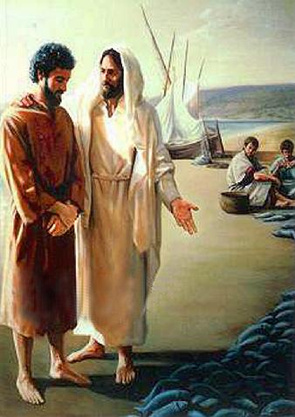
“…do you love me more than these…”
Boats, nets, fish?
Is your job
- your identity
- the source or channel
Fall back plan
-
Emotional response
-
Distraction (shop, eat,
game, holiday, busy serving)
neighbourhood?
Your safe familiar environment
relationships?
Your family/friends
Notes:
When the going gets touch – where do you get going to?

Slide 21

Running for the prize
²⁴ Do you not know that in a race all the runners run, but only one gets the prize? Run in such a way as to get the prize. ²⁵ Everyone who competes in the games goes into strict training. They do it to get a crown that will not last, but we do it to get a crown that will last forever. ²⁶ Therefore I do not run like someone running aimlessly; I do not fight like a boxer beating the air. ²⁷ No, I strike a blow to my body and make it my slave so that after I have preached to others, I myself will not be disqualified for the prize.
- 1 Cor 9:24-27

Slide 22
Response
Ask Him to become the prize - Restore for me the joy of my salvation (Ps51:12)
Fan into flame the gift of God which is in you (2 Tim 1:6)
Repent – “I have put other things above you. I have used You to better my life. Now I’m saying use my life to better Yours.”
Notes:
Fan – you might have a memory trace of eternity/ you remember once being hungry for God – stir it up/fan it into flames
[Song: Here for you/when I survey - All the vain things]

