Slide 1
Jesus & Zacchaeus the Tax Collector
Luke 19:1-10
Notes:
Zacchaeus the Tax Collector
Luke 19:1-10

Slide 2
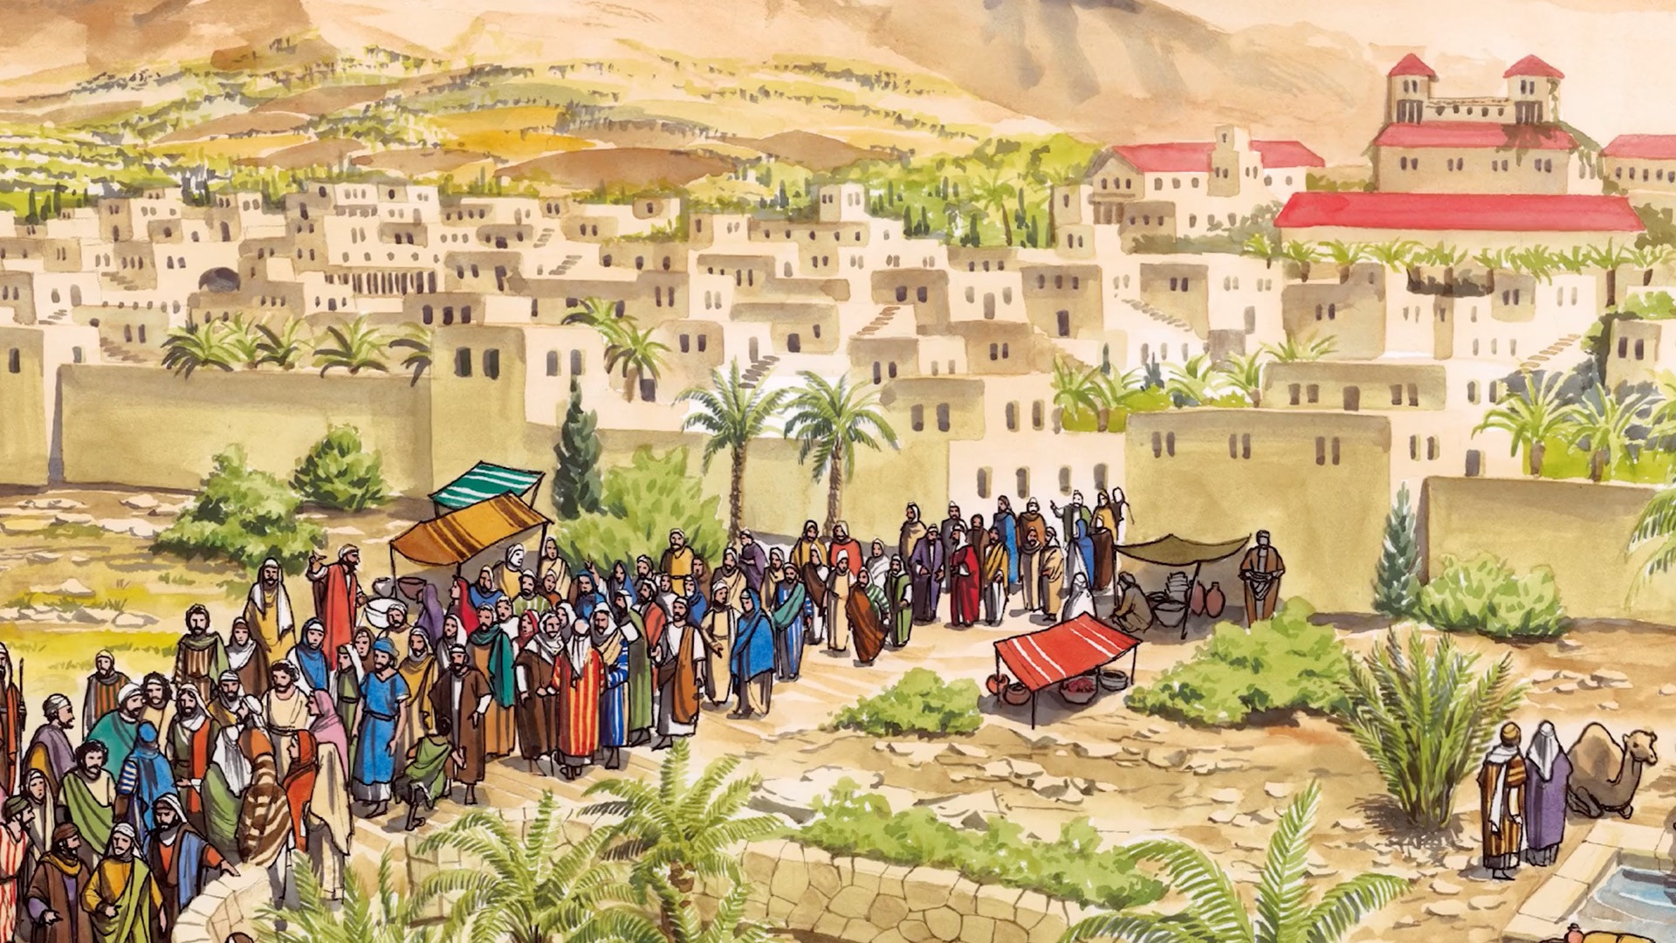
¹ Jesus entered Jericho and was passing through.
Notes:
¹ Jesus entered Jericho and was passing through.

Slide 3
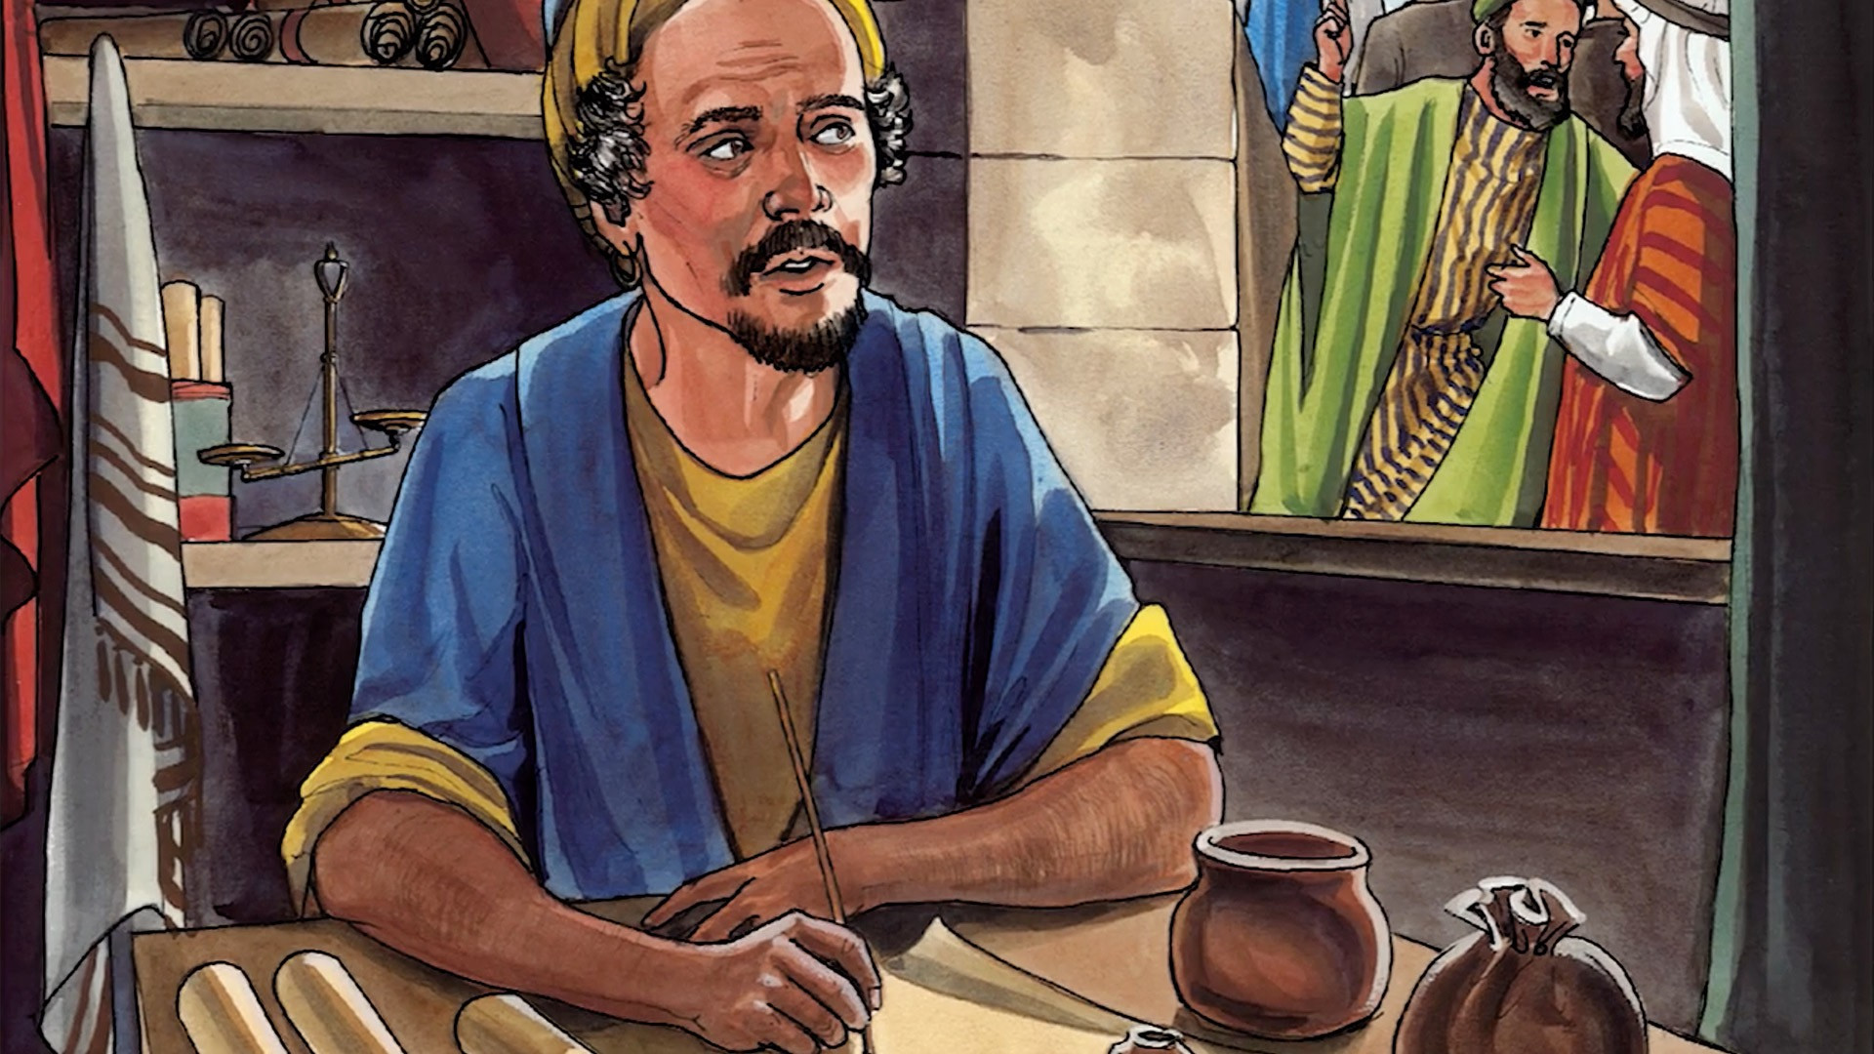
² A man was there by the name of Zacchaeus; he was a chief tax collector and was wealthy.
Notes:
² A man was there by the name of Zacchaeus; he was a chief tax collector and was wealthy.

Slide 4
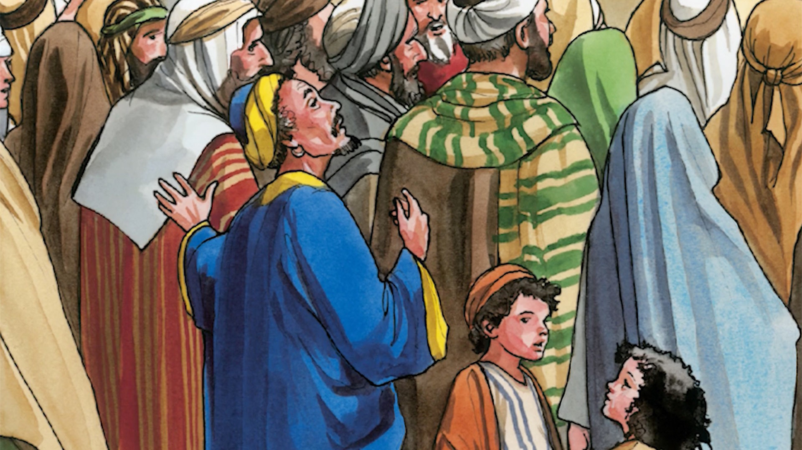
³ He wanted to see who Jesus was, but because he was short he could not see over the crowd.
Notes:
³ He wanted to see who Jesus was, but because he was short he could not see over the crowd.

Slide 5
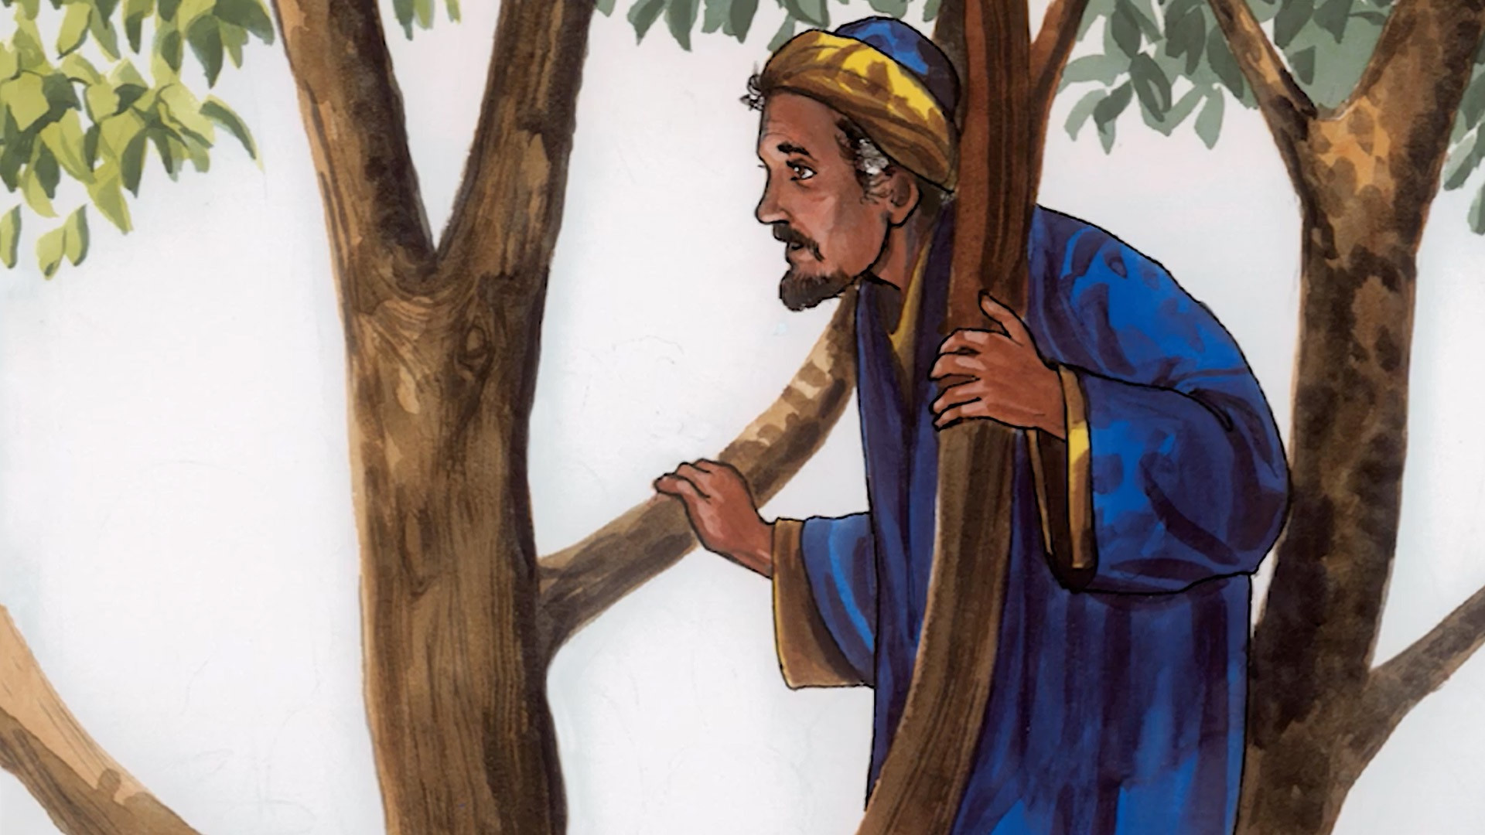
⁴ So he ran ahead and climbed a sycamore-fig tree to see him, since Jesus was coming that way.
Notes:
⁴ So he ran ahead and climbed a sycamore-fig tree to see him, since Jesus was coming that way.

Slide 6
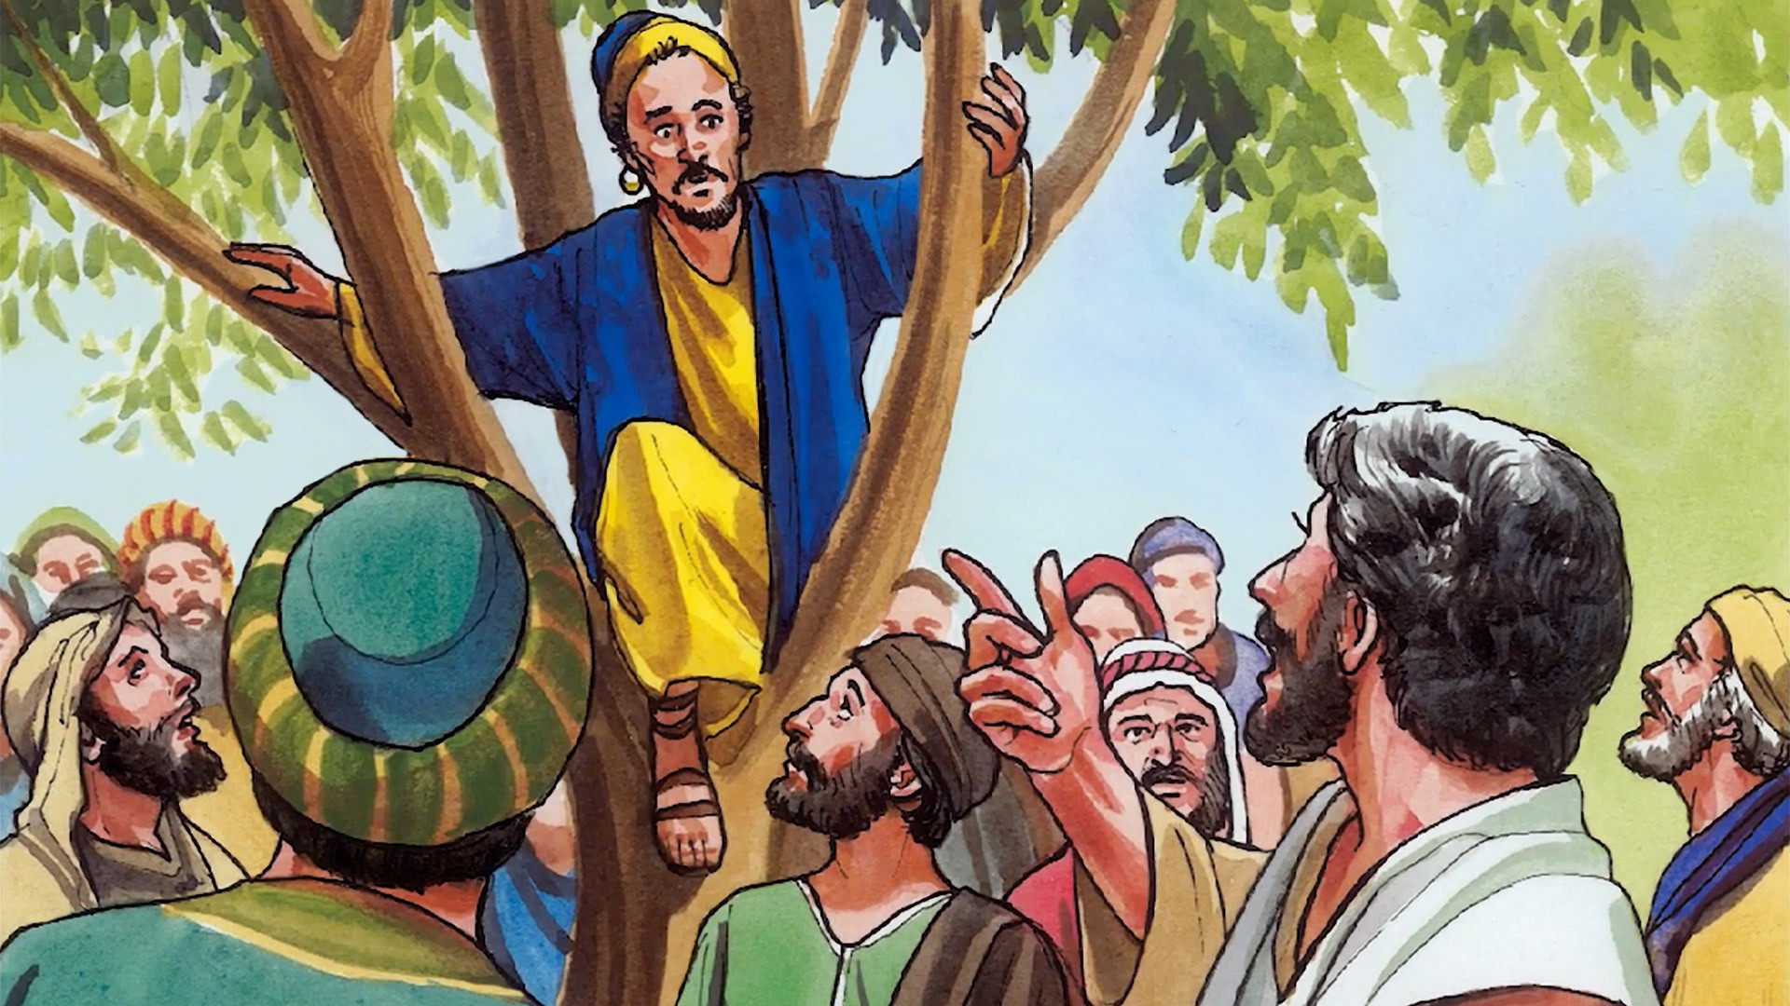
⁵ When Jesus reached the spot, he looked up and said to him, “Zacchaeus, come down immediately. I must stay at your house today.”
Notes:
⁵ When Jesus reached the spot, he looked up and said to him, “Zacchaeus, come down immediately. I must stay at your house today.”

Slide 7
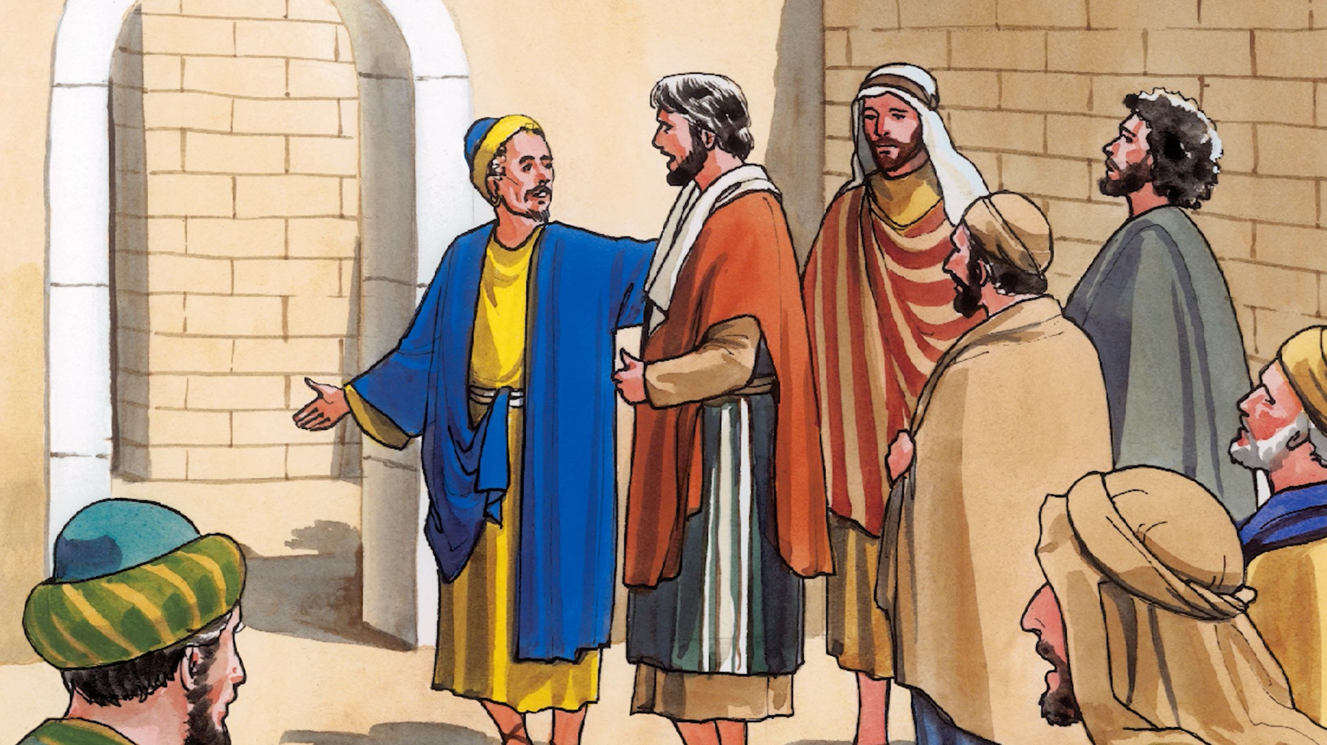
⁶ So he came down at once and welcomed him gladly.
Notes:
⁶ So he came down at once and welcomed him gladly.

Slide 8
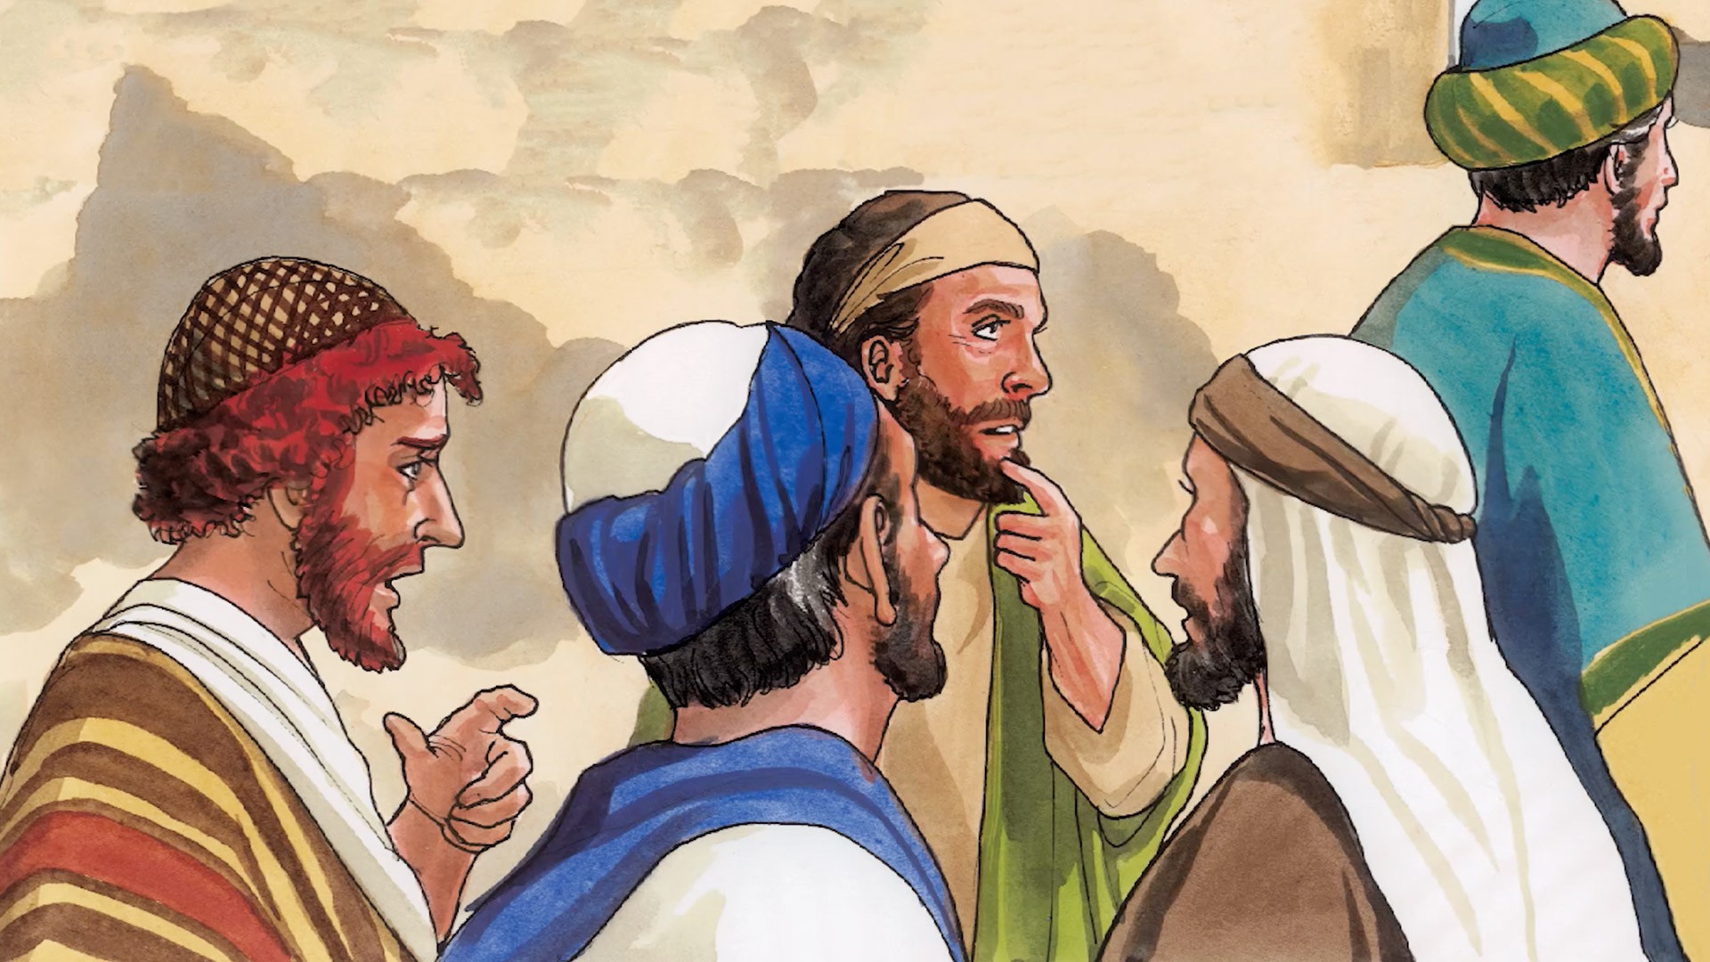
⁷ All the people saw this and began to mutter, “He has gone to be the guest of a sinner.”
Notes:
⁷ All the people saw this and began to mutter, “He has gone to be the guest of a sinner.”

Slide 9
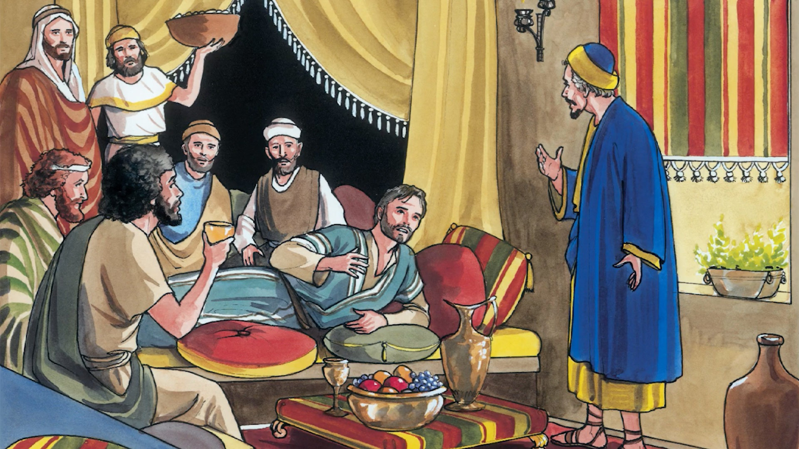
⁸ But Zacchaeus stood up and said to the Lord,
“Look, Lord! Here and now I give half of my possessions to the poor, and if I have cheated anybody out of anything, I will pay back four times the amount.”
“Today salvation has come to this house, because this man, too, is a son of Abraham. For the Son of Man came to seek and to save the lost.”
Notes:
⁸ But Zacchaeus stood up and said to the Lord, “Look, Lord! Here and now I give half of my possessions to the poor, and if I have cheated anybody out of anything, I will pay back four times the amount.”
⁹ Jesus said to him, “Today salvation has come to this house, because this man, too, is a son of Abraham. For the Son of Man came to seek and to save the lost.”

